Slide 1

World Population Outlook
Gerhard K. Heilig
Presentation prepared for the “International School on Energy Systems” of the
Forschungszentrum Jülich - organized at Kloster Seeon, Germany on September 3-8, 2017
Contact:
Gerhard K. Heilig, Waldheimstrasse 29, 3004 Riederberg, Austria
e-mail: gerhard.heilig@gmail.com; website: www.gerhard-k-heilig.com
Disclaimer: This PowerPoint presentation is not a United Nations publication. Views expressed are my own and do not imply the expression of any opinion on the
part of any international organization or research institute. However, this presentation is using data from the official United Nations World Population Prospects,
the World Urbanization Prospects and the Probabilistic Population Projections for all countries of the world.

Slide 2
World Population Outlook
Content
1
Population size
Population distribution
Population density
Urbanization / settlement type
Age structure
Dynamics: Fertility & mortality
2
3
4
5
6

Slide 3
World Population Outlook
1
Population Size
We are in the middle of an epochal demographic
transition. Within only 150 years, the world population
will increase between 1950 and 2100 by
8.7 billion people.

Slide 4
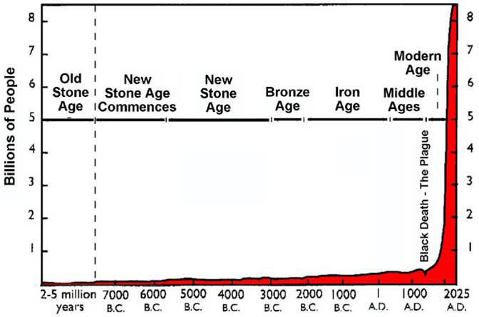
1
Modern “Population Explosion”
Scale would have to be extended by 492 feet (150 m)
to correctly represent world population growth.

Slide 5
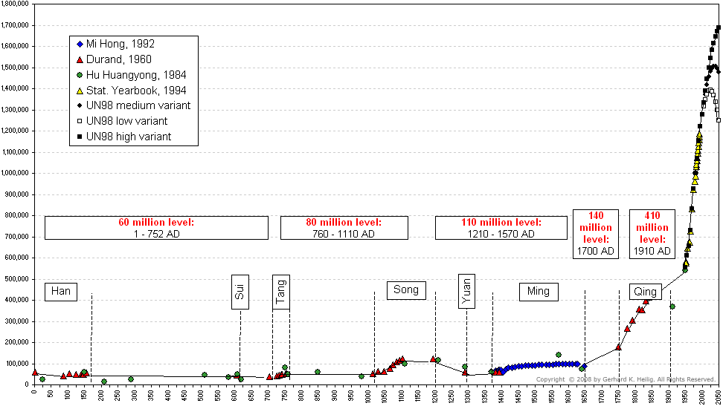
1
Evidence: Example China
China's population, A.D. 0 - 2050
2010: 1.35 billion
Source: This chart was compiled by the author from the following sources: 1) Durand, J.D. (1960): The population statistics of China, A.D. 2 - 1953. In: Population Studies, Vol. 13, No. 3, 209-256; (2) Mi, Hong (1992): The quantitative analysis about evolution of historical population on Ming Dynasty in China. Paper presented at the IUSSP General Conference, Session 40, Montreal; (3) Hu Huanyong (Ed.) (1984): The population geography of China. Shanghai (East China Normal University Press), p. 10 (taken from Susumu Yabuki (1995): China's new political economy. The giant awakes. Boulder, San Francisco, Oxford, Westview Press, p.96); (4) China Statistical Yearbook, 1994, Beijing. China Statistical Publishing House. (5) United Nations (1999): World Population Prospects. The 1998 Revision. New York (from data files on diskettes)

Slide 6
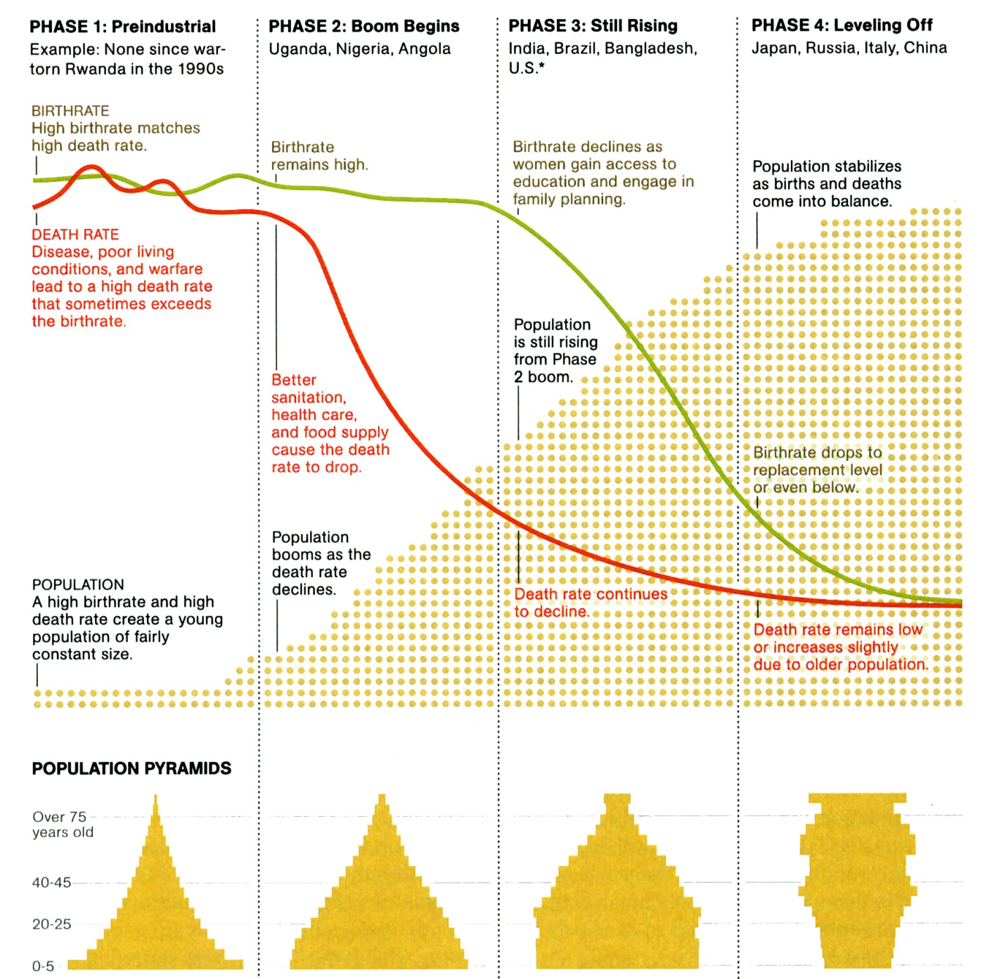
1
What has caused modern pop. explosion?
The unprecedented increase in the world population did not happen because we were breeding like rabbits, but because we were no longer dying like flies.

Slide 7

1
(Legitimate) Children of Luis XIV of France
Louis von Frankreich „Grand Dauphin“ (* 1661; † 1711)
Anne Élisabeth von Frankreich (* 1662; † 1662)
Marie Anne von Frankreich (* 1664; 1664)
Marie Thérèse von Frankreich (* 1667; † 1672)
Philippe Charles von Frankreich (* 1668; † 1671)
Louis François von Frankreich (* 1672; † 1672)

Slide 8
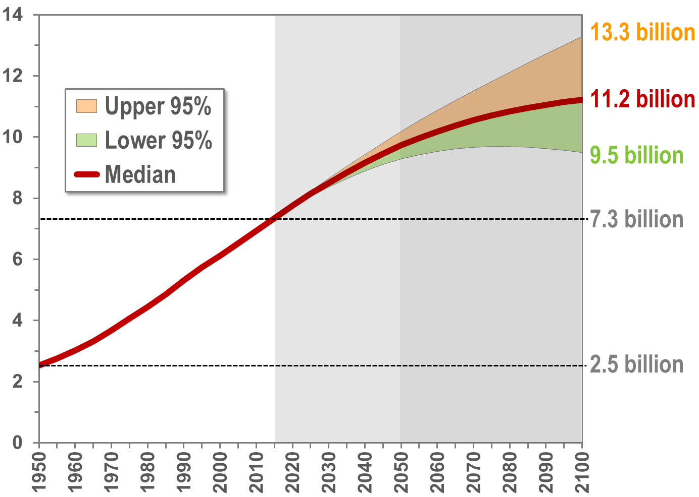
1
World: Population, 1950-2100 (billion)
9.7
Source: United Nations Department of Economic and Social Affairs, Population Division: World Population Prospects, the 2015 Revision. New York

Slide 9
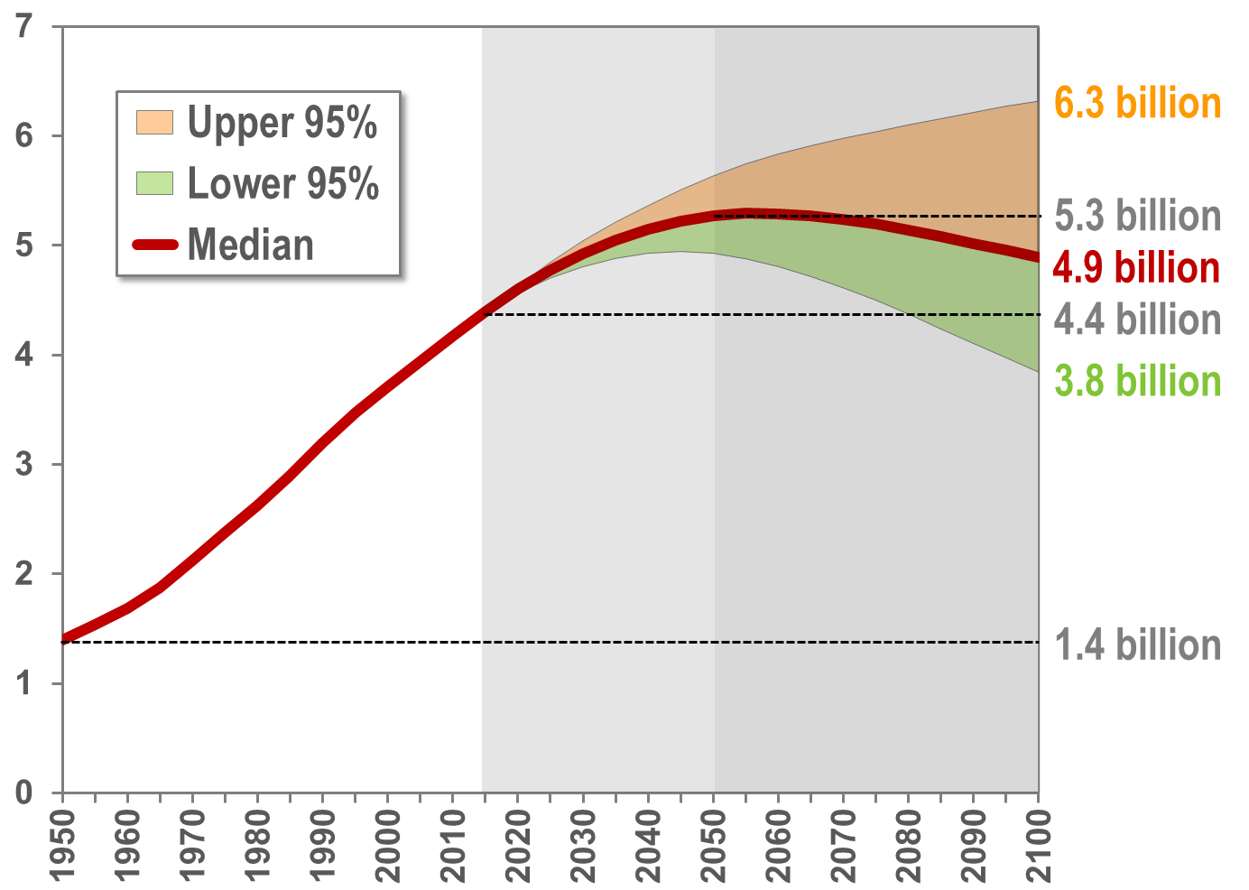
1
Asia: Population, 1950-2100 (billion)
5.3
Source: United Nations Department of Economic and Social Affairs, Population Division: World Population Prospects, the 2015 Revision. New York

Slide 10
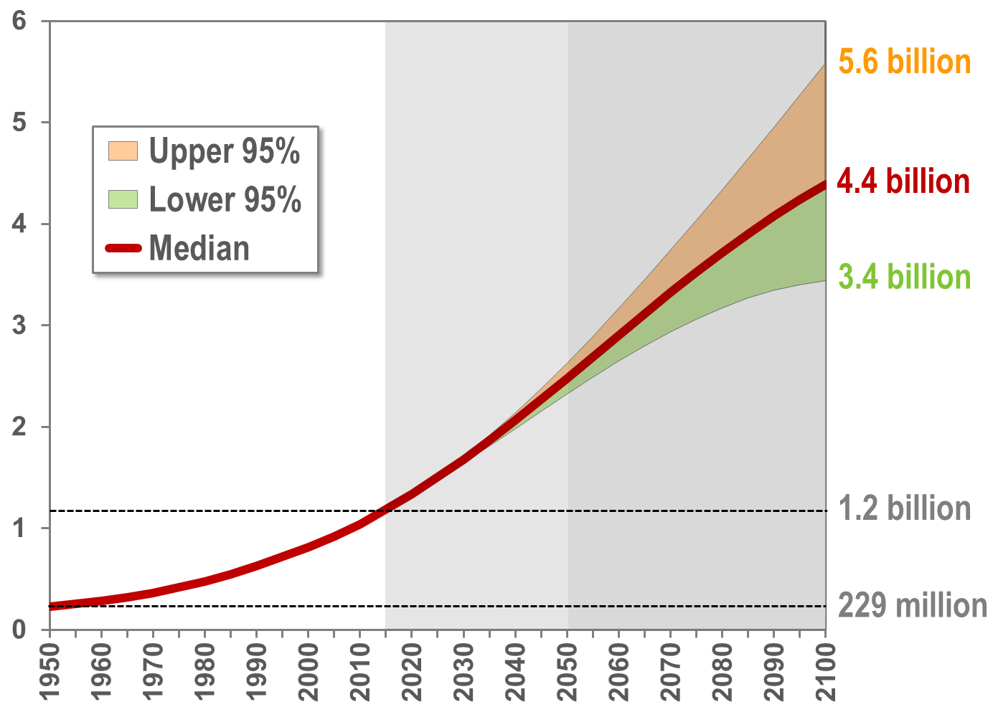
1
Africa: Population, 1950-2100 (billion)
2.5
Source: United Nations Department of Economic and Social Affairs, Population Division: World Population Prospects, the 2015 Revision. New York

Slide 11
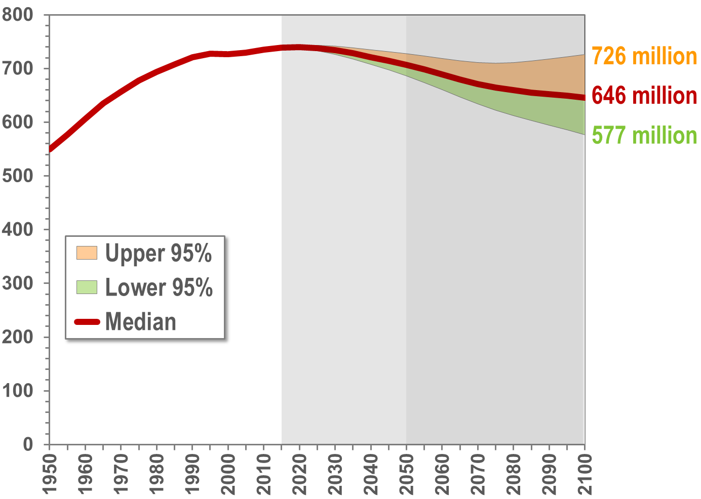
1
Europe: Population, 1950-2100 (million)
707
Source: United Nations Department of Economic and Social Affairs, Population Division: World Population Prospects, the 2015 Revision. New York

Slide 12
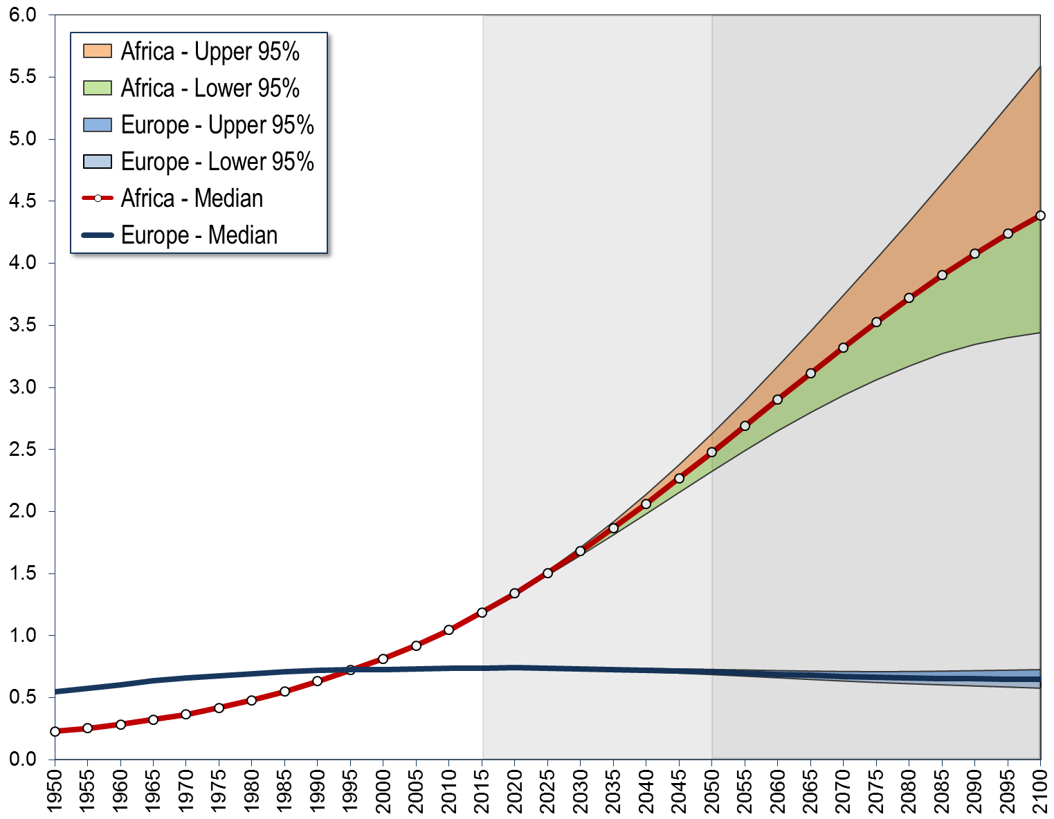
1
Africa - Europe: Population, 1950-2100 (million)
4,387
2,478
1,186
549
738
707
646
229
Source: United Nations Department of Economic and Social Affairs, Population Division: World Population Prospects, the 2015 Revision. New York

Slide 13
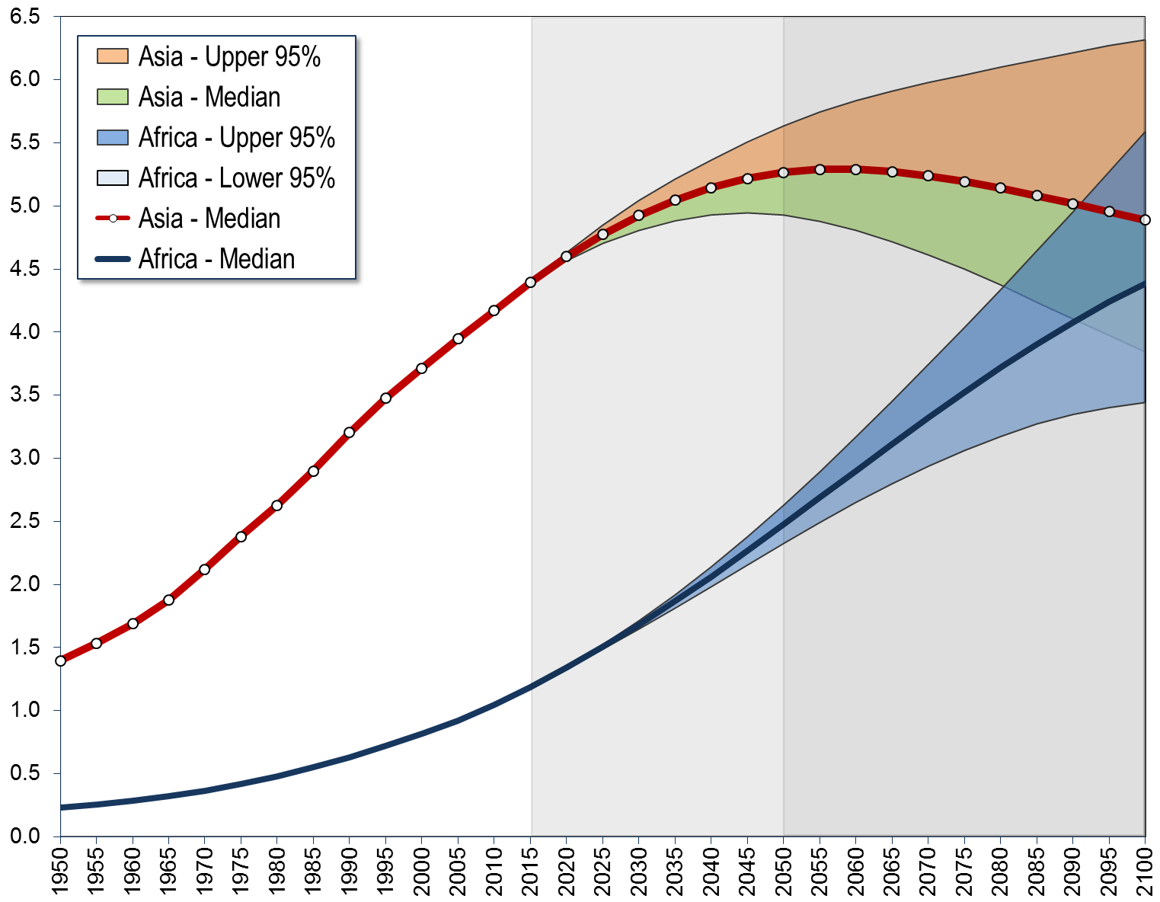
1
Asia - Africa: Population, 1950-2100 (billions)
5.267
4.889
4.393
4.387
2.478
1.394
1.186
0.229
Source: United Nations Department of Economic and Social Affairs, Population Division: World Population Prospects, the 2015 Revision. New York

Slide 14
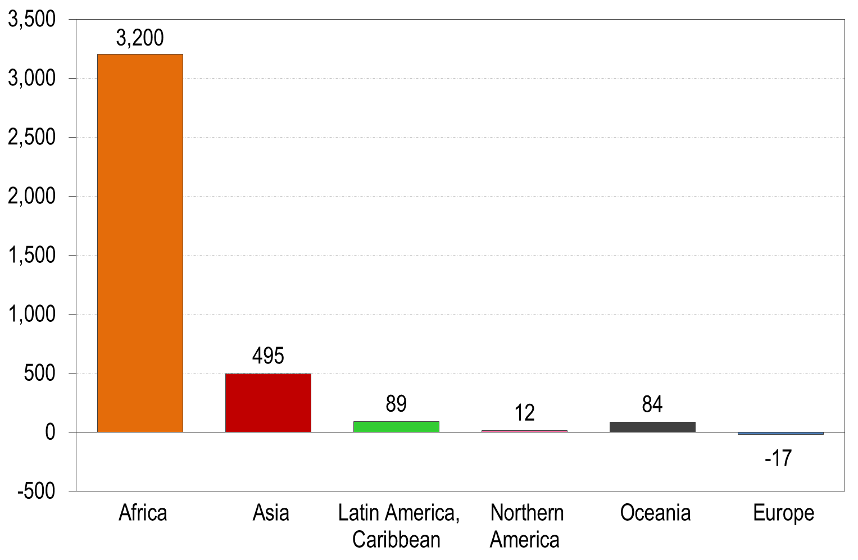
1
Population growth or decline, 2015-2100 (millions)
Source: United Nations Department of Economic and Social Affairs, Population Division: World Population Prospects, the 2015 Revision. New York

Slide 15
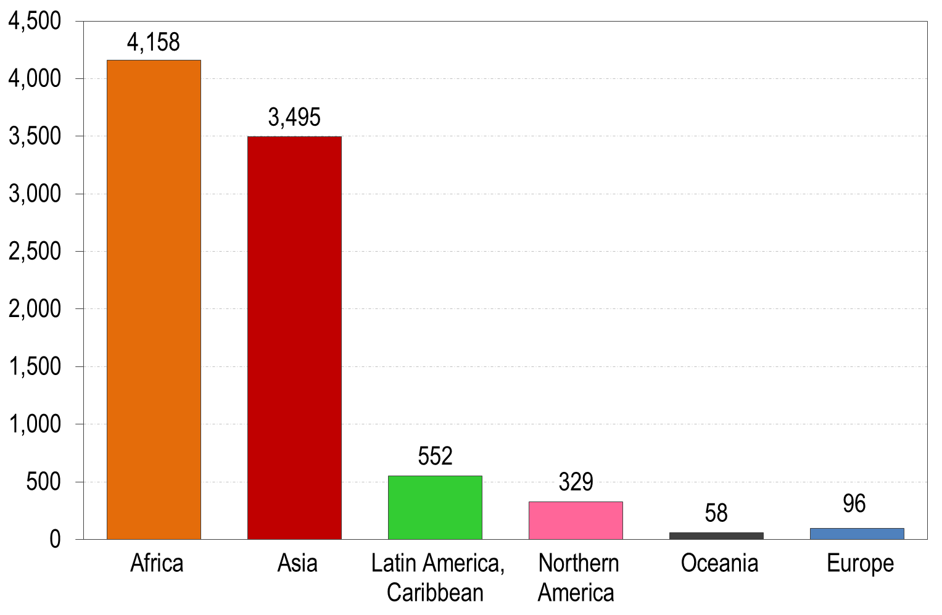
1
Population growth, 1950-2100 (millions)
Source: United Nations Department of Economic and Social Affairs, Population Division: World Population Prospects, the 2015 Revision. New York

Slide 16
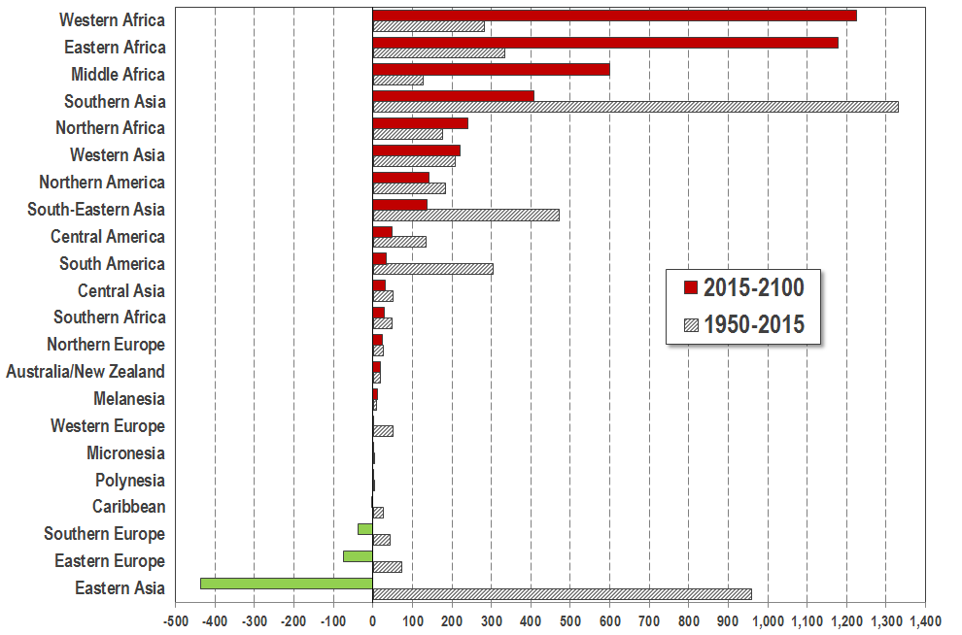
1
Population change, 1950-2015-2100 (millions)
Source: United Nations Department of Economic and Social Affairs, Population Division: World Population Prospects, the 2017 Revision. New York

Slide 17
1
Population increase: Top-20 countries (millions)
Past 65 years
Next 35 years
Source: United Nations Department of Economic and Social Affairs, Population Division: World Population Prospects, the 2015 Revision. New York

Slide 18
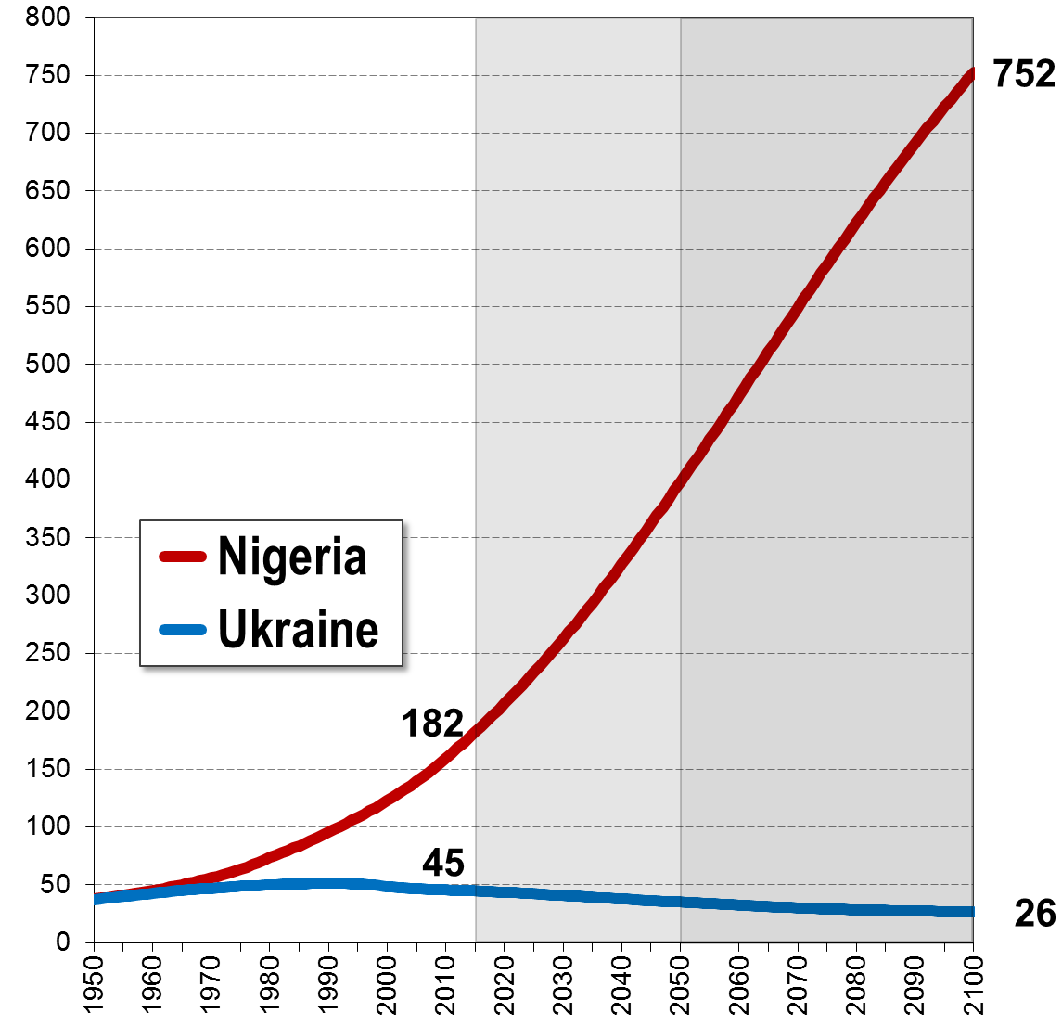
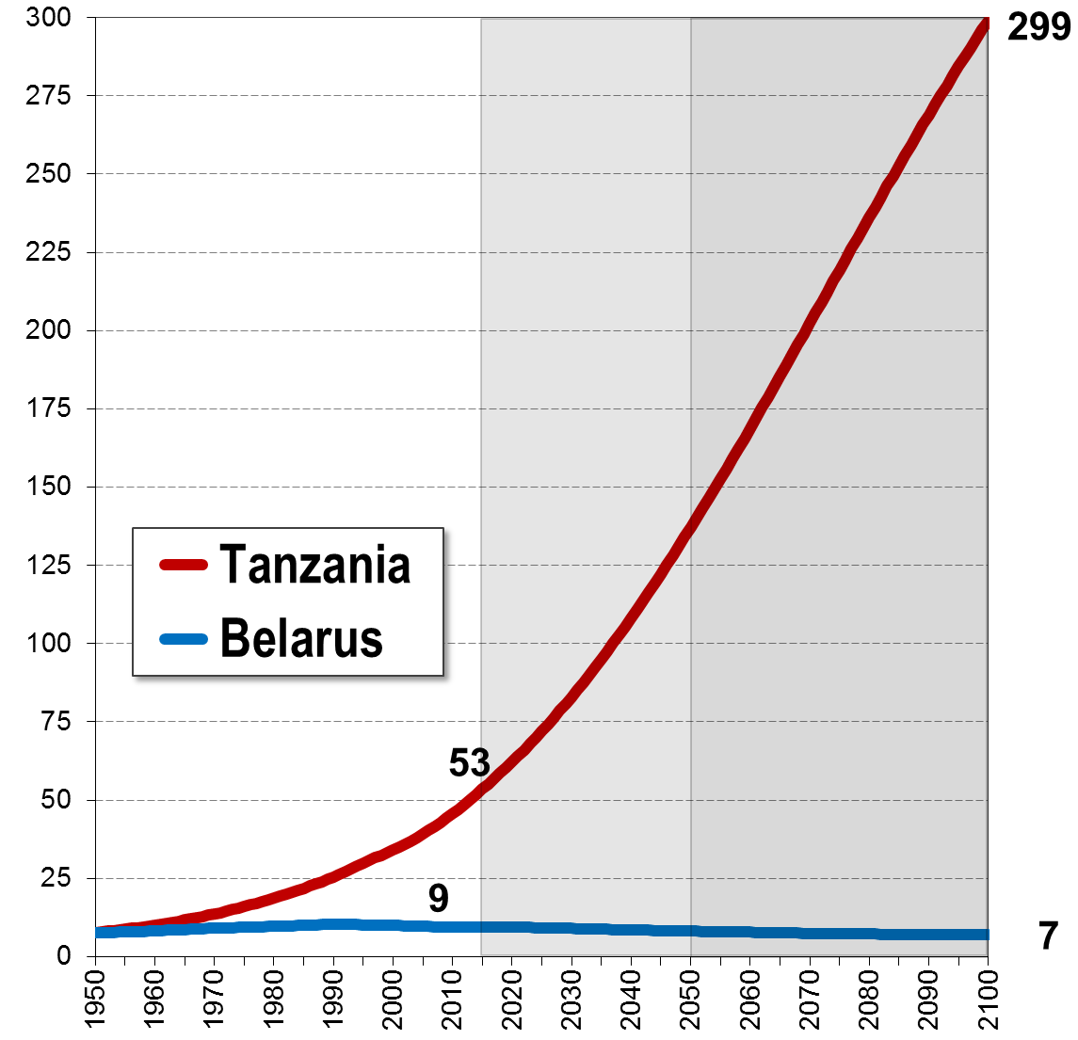
1
African and European populations, 1950-2100
Countries with similar population size in 1950 (millions)
Both Nigeria and the Ukraine had a population of around 38 million in 1950. Today, Nigeria has a population of 182 million; in 2050 it will be 399 million. By the end of the century Nigeria could have a population of 752 million – while the Ukraine will probably decline to 26 million.
Source: United Nations Department of Economic and Social Affairs, Population Division: World Population Prospects, the 2015 Revision. New York

Slide 19
World Population Prospects
2
Share of global population
By the end of the 21st century
39% of the world population will be
people from Africa.
Europe will contribute less than 6%
to the world population.

Slide 20
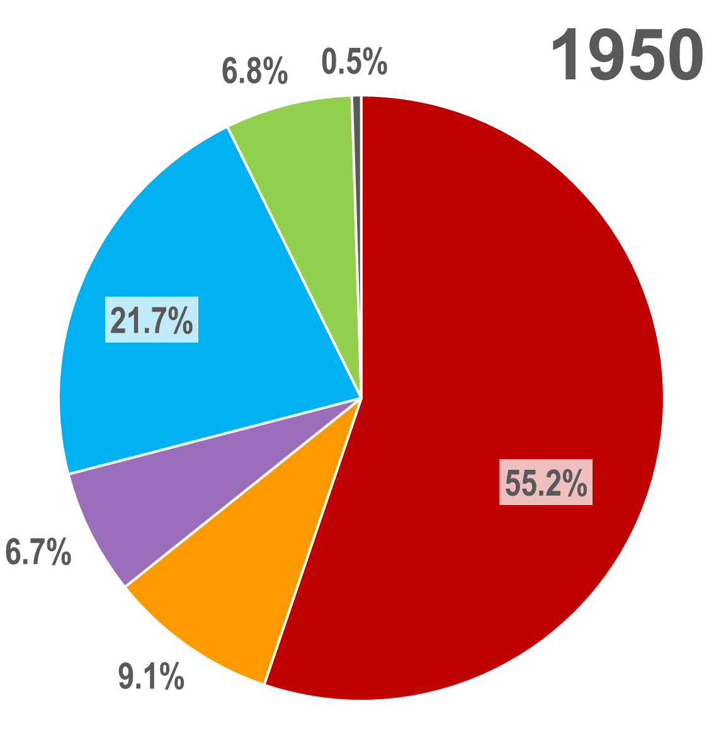
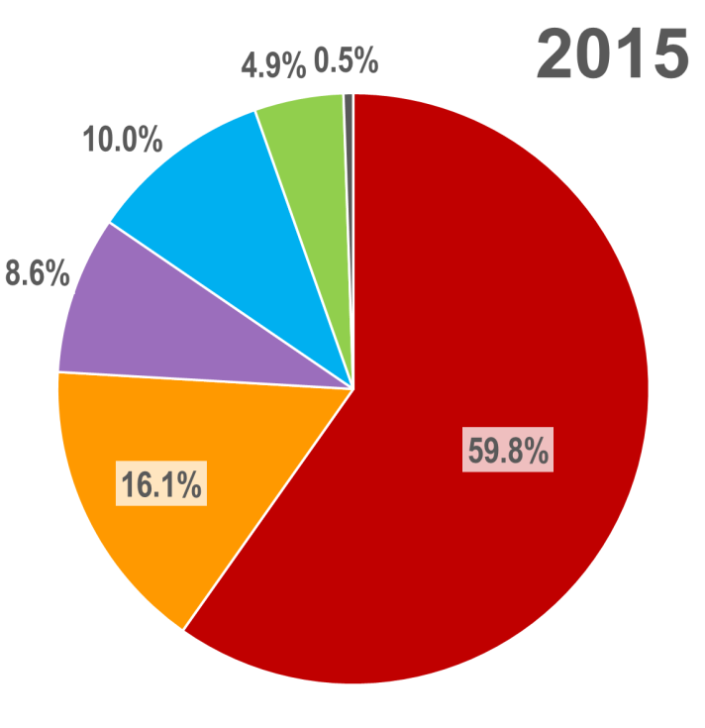
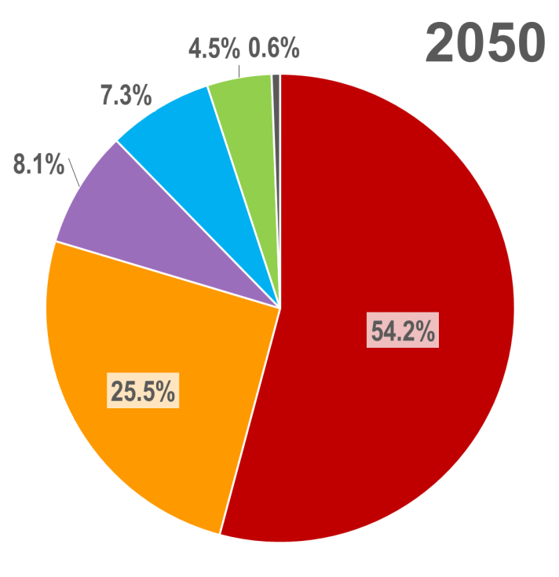
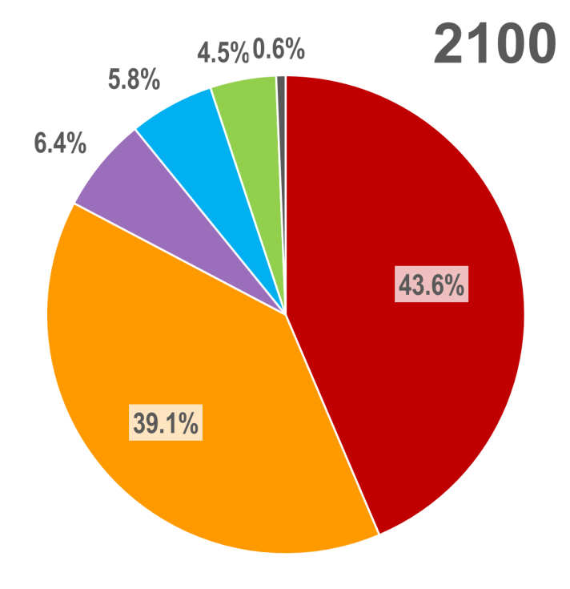
2
Population by major region, 1950-2100
Source: WPP2015

Slide 21
2
Share of world population
Africa‘s
  share of the world population will more than triple between 1950
  and 2100 - from 9% to 39%.
Asia’s
  share of the world population has increased from 55% in 1950 to
  almost 60% today. It will shrink again and reach 44% by 2100.
Europe‘
  share of the world population was about 22% in 1950. It is now down
  to only 10% and it will further decline to less than 6%.
Northern America‘s
  share will change very little and fluctuate between 5% and 7%.
Latin America‘s
  share will also change little and fluctuate between 6.7% and 8.6%.
Source: WPP2015

Slide 22
World Population Prospects
3
Population density
Population density will be higher in some
parts of Asia and Africa than in Europe.
Almost all future population growth will be in
urban areas – usually by expansion of slums.

Slide 23
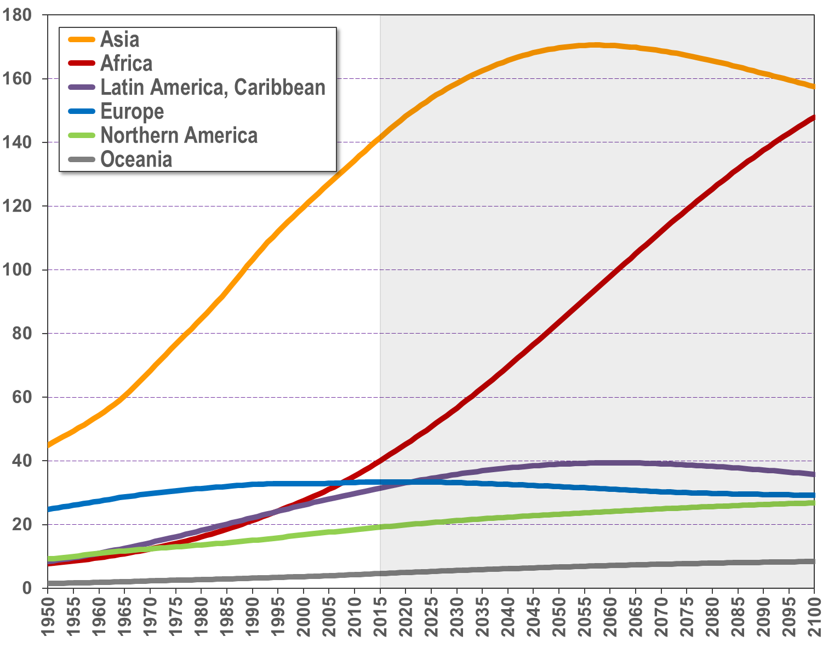
3
Population density by major region (people per sqkm)
158
148
142
40

Slide 24
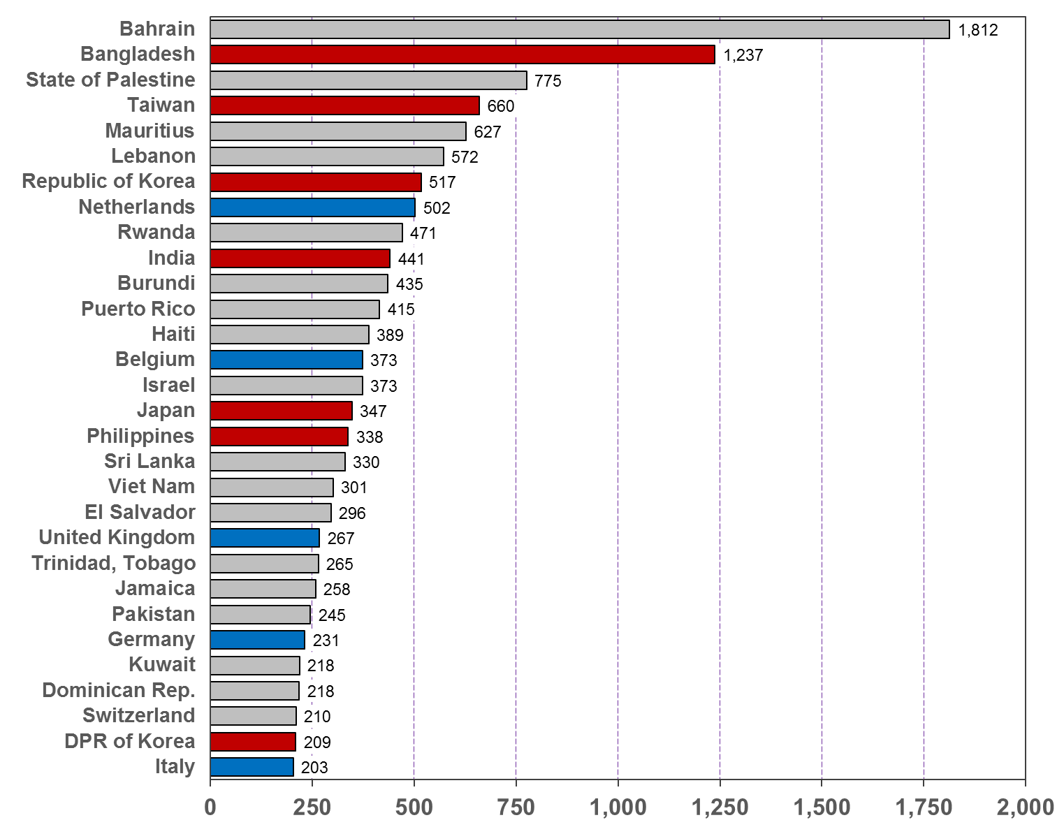
3
Population density: Top-30 countries in 2015
People per sqkm

Slide 25
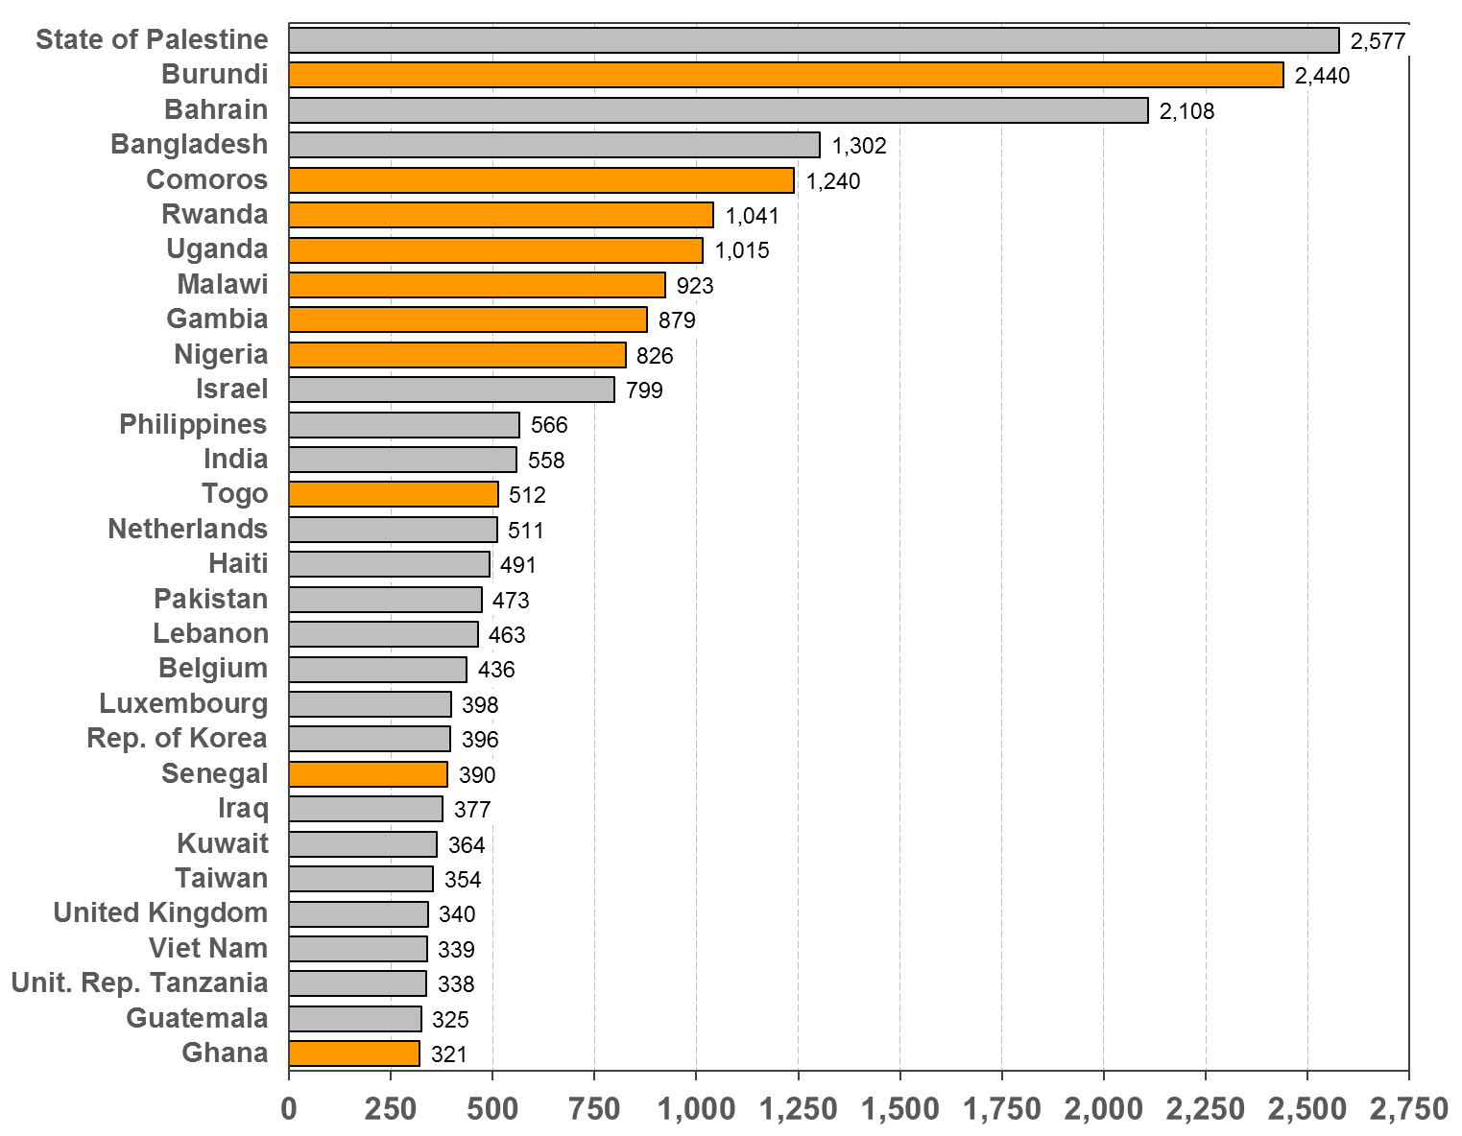
3
Population density: Top-30 countries in 2100
People per sqkm

Slide 26
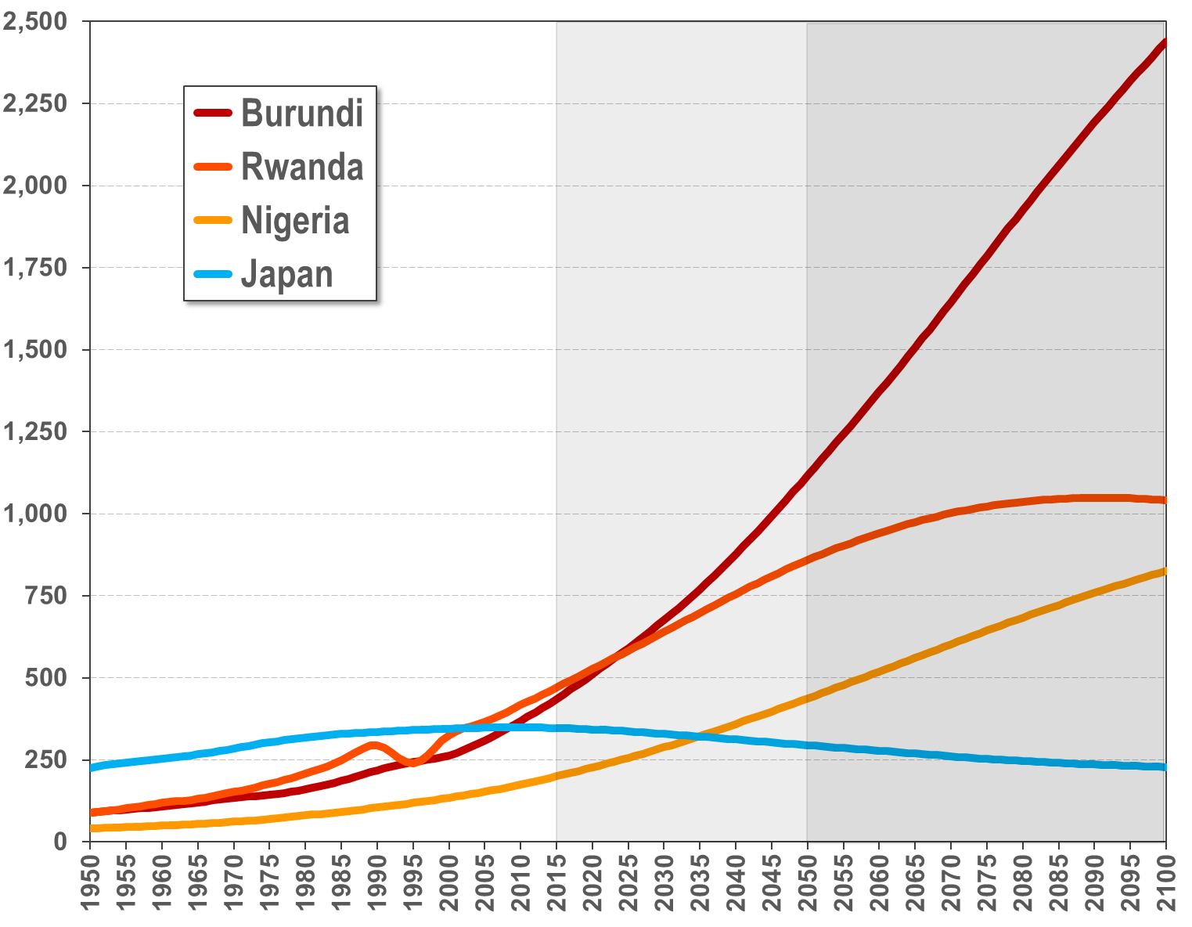
3
Selected population densities: 1950-2100
Almost 11 times the density of Japan
2,440
Persons per square kilometre
3.8 times the density of Japan
1,041
1,041
228

Slide 27
World Population Prospects
4
Urbanization
Almost all future population growth will be in
urban areas – usually by expansion of slums.

Slide 28
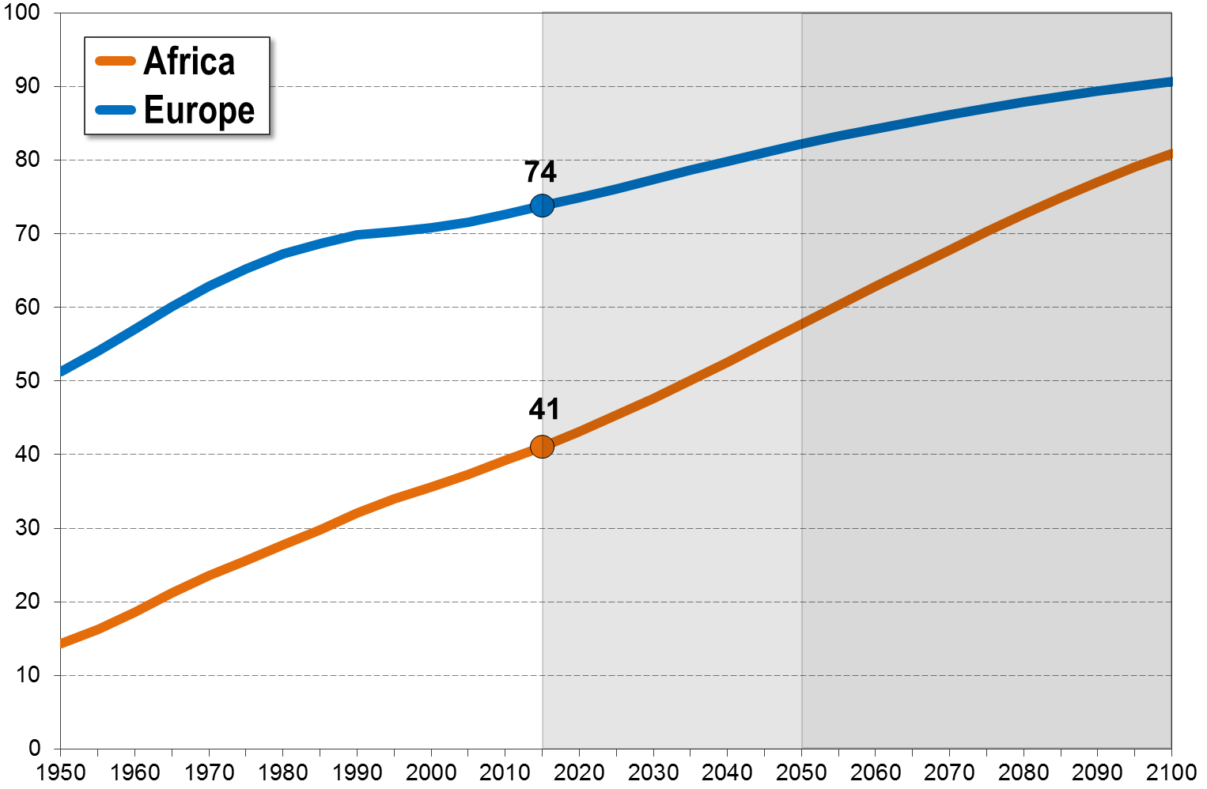
4
Africa - Europe: Urbanization, 1950-2100 (% urban)

Slide 29
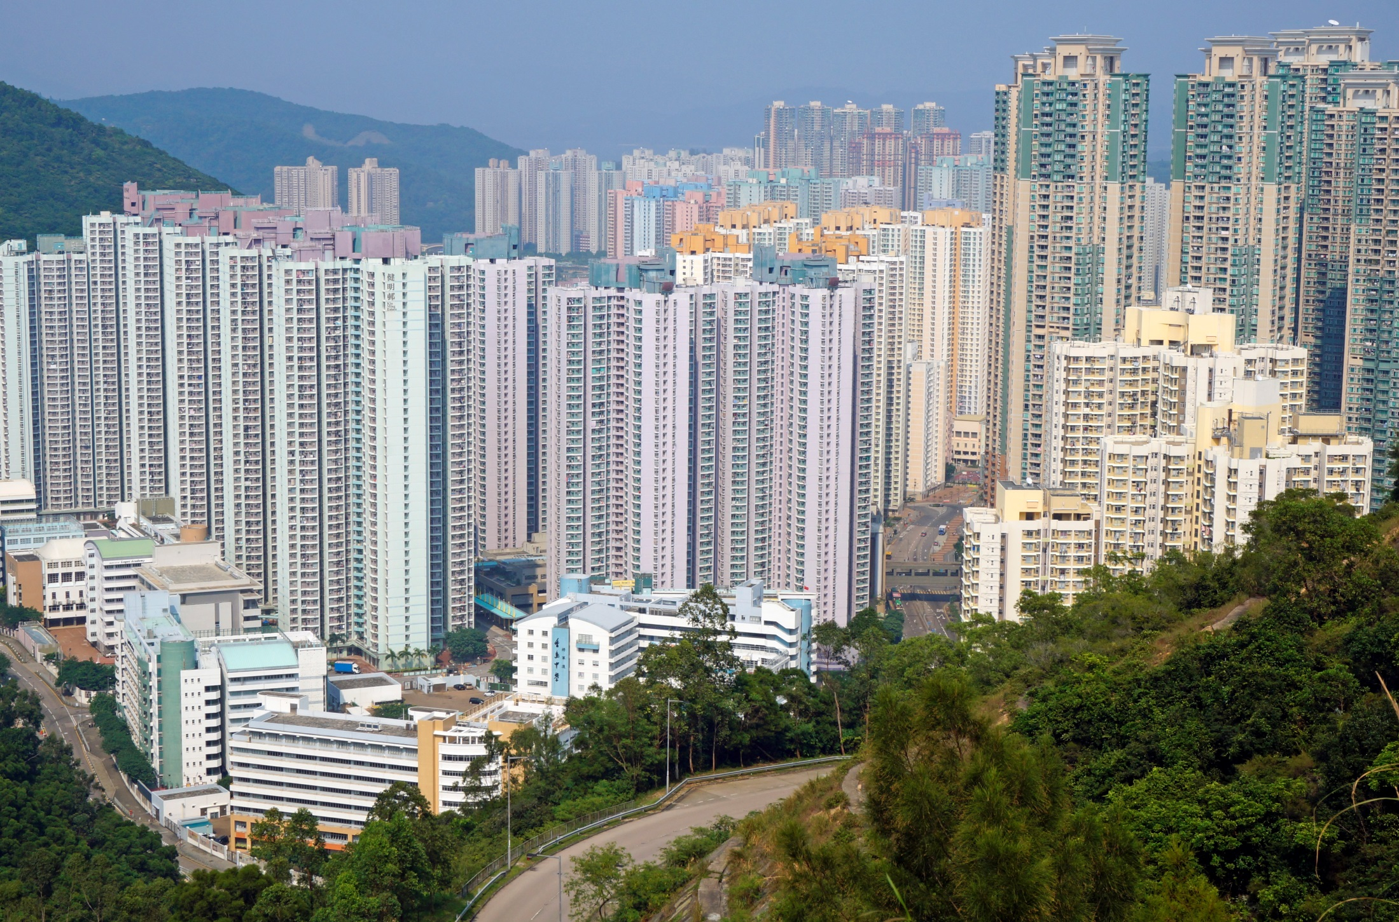
4
Asia: Urban quality of life?
"Kin Ming Estate 2013 10 part2" by Qwer132477 - Own work. Licensed under CC BY-SA 3.0 via Wikimedia Commons - https://commons.wikimedia.org/wiki/File:Kin_Ming_Estate_2013_10_part2.JPG#/media/File:Kin_Ming_Estate_2013_10_part2.JPG

Slide 30
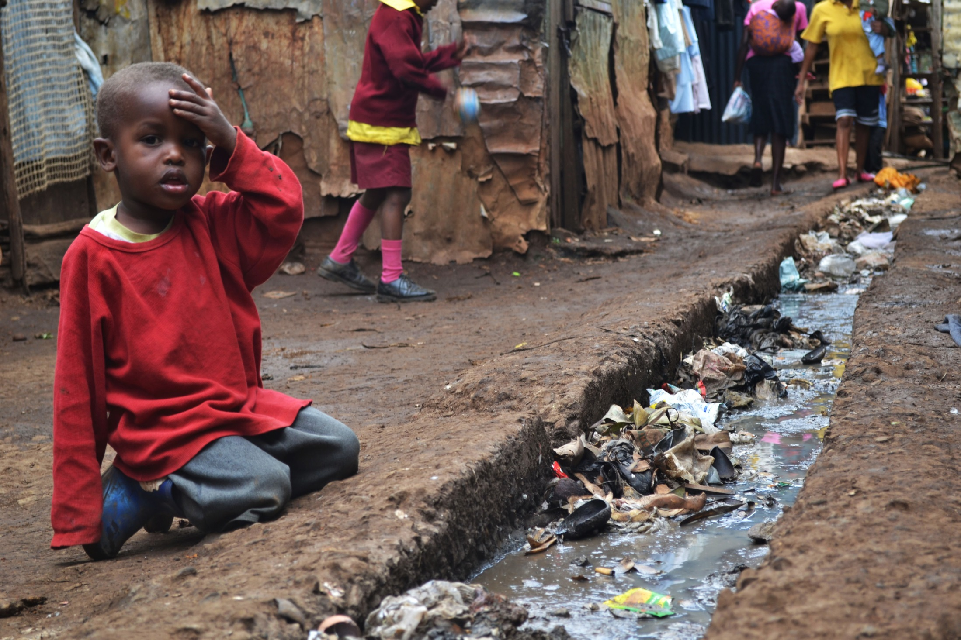
4
Africa: Kibera – Slum, Nairobi
A young boy sits over an open sewer in the Kibera slum, Nairobi. Photo by Trocaire. Licensed under CC BY 2.0 via Wikimedia Commons.

Slide 31
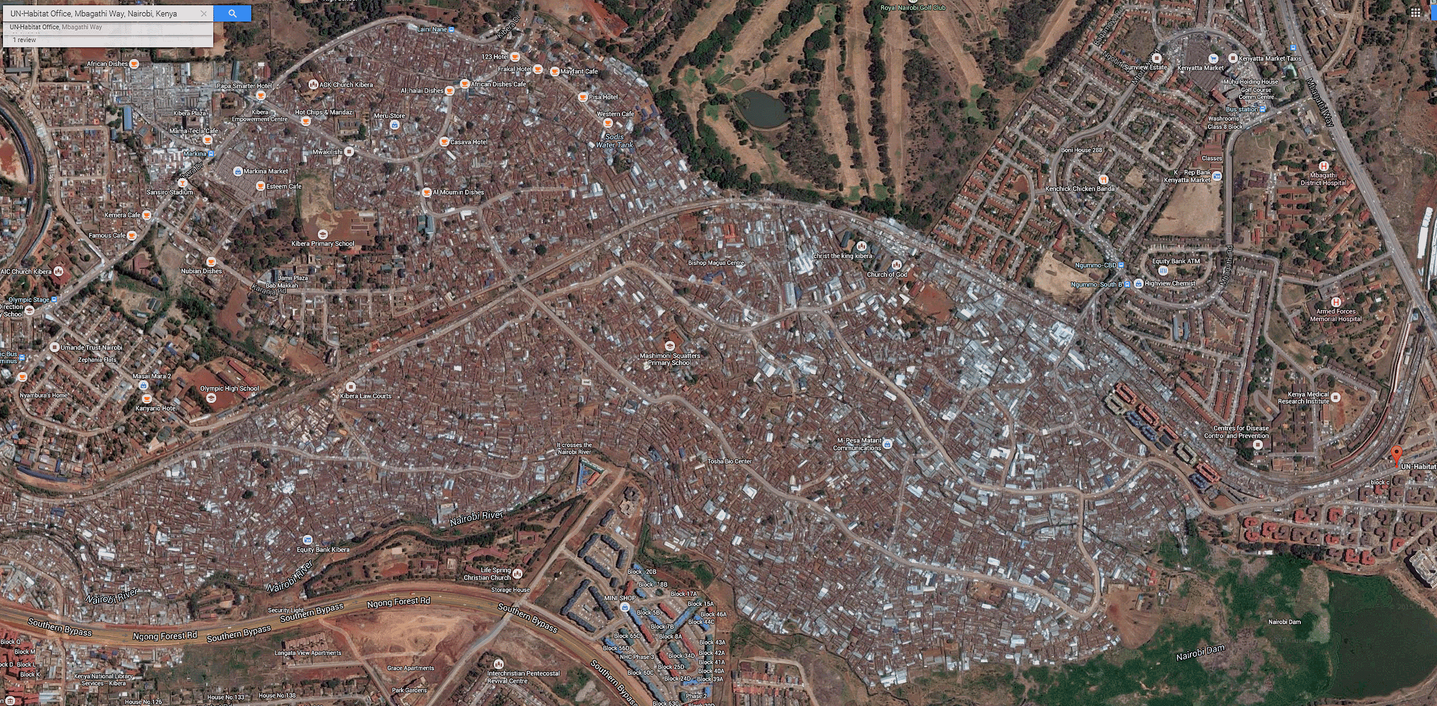
4
Africa: Failure of international organizations
UN-HABITAT headquarters and Kibera-Slum, Nairobi (one of the largest in Africa)
Golf
course
Kibera
Slum
UN
HABITAT

Slide 32
4
Africa: Failure of international organizations
Kibera, a suburb of Nairobi, is the largest slum in Africa with more than one million inhabitants. Children playing amidst piles of garbage, with no running water and the stench of sewage and waste everywhere. Right on the boarder of Kibera are the headquarters of UN-HABITAT – the agency that should bring
adequate shelter for all.
Source: Dambis Moyo: Why Foreign Aid Is Hurting Africa.
The Wall Street Journal, March 21, 2009

Slide 33
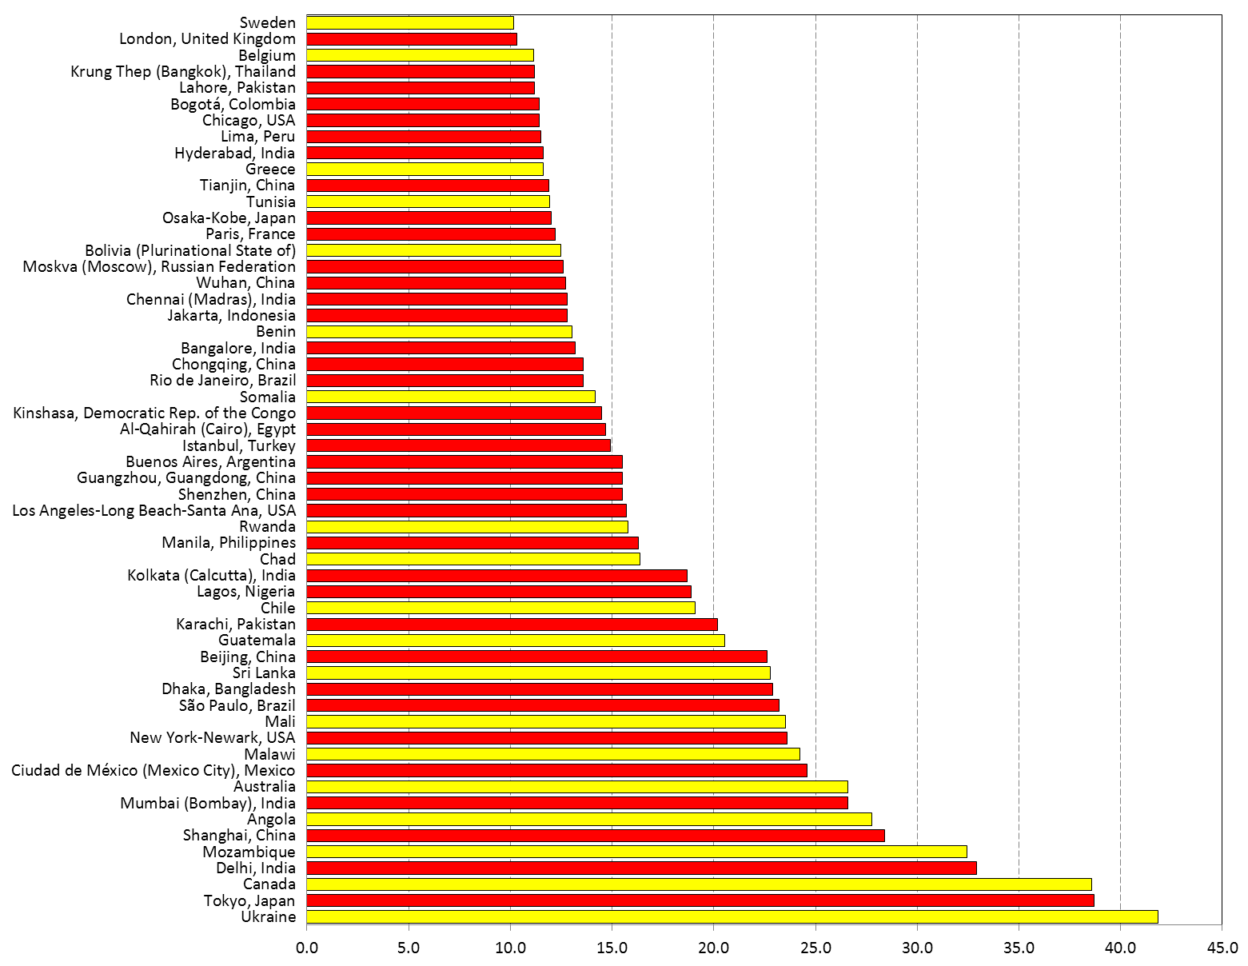
4
Mega-Cities und selected countries (in 2025)
Somalia
Cairo
Lagos
Chile
Mozambique
Delhi

Slide 34
World Population Prospects
5
Population age structure
Africa is a continent of children,
and young adults.
Europa is a continent of older people
– with increasing population aging.

Slide 35
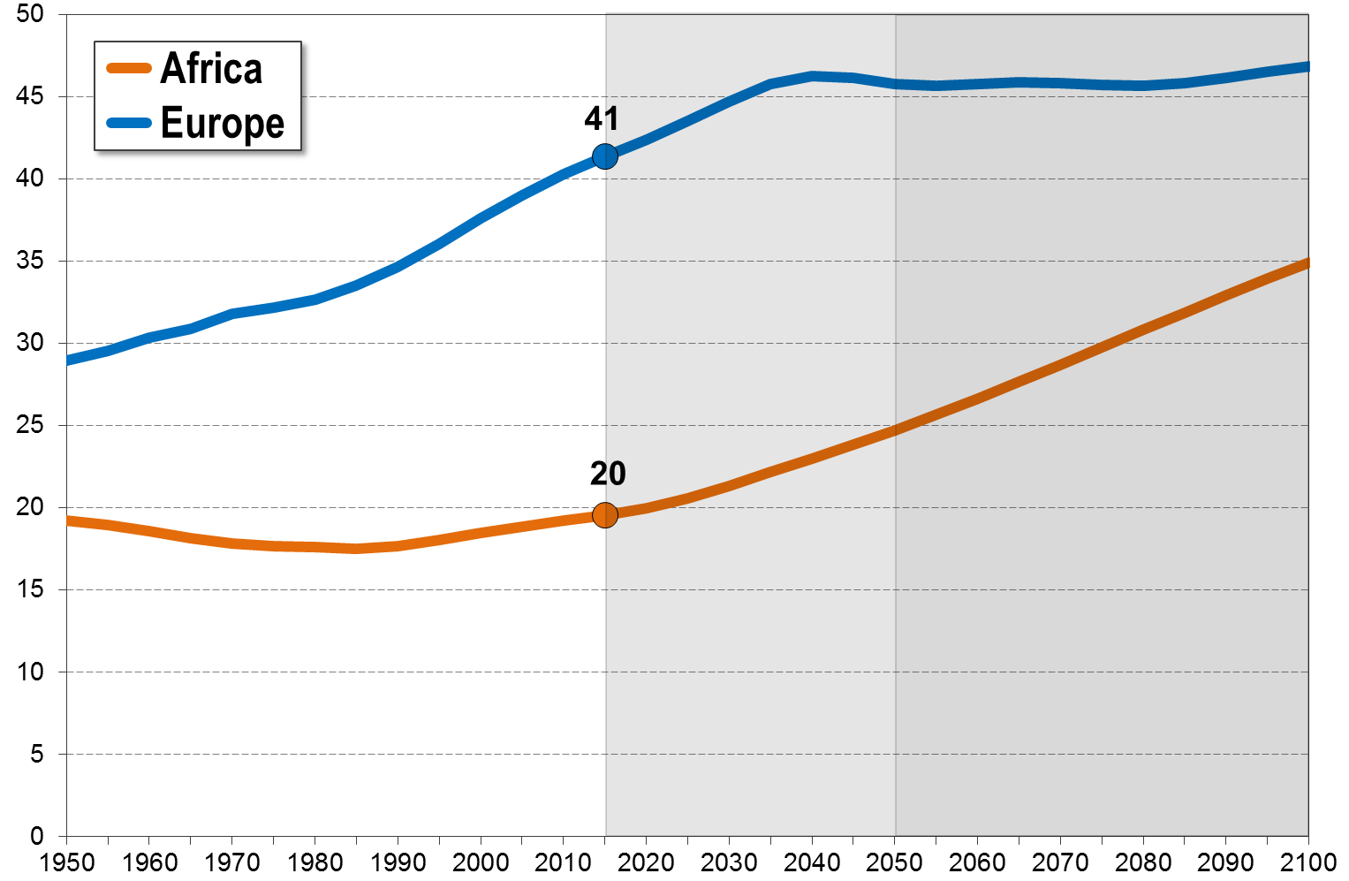
5
Africa - Europe: Median age, 1950-2100 (years)

Slide 36
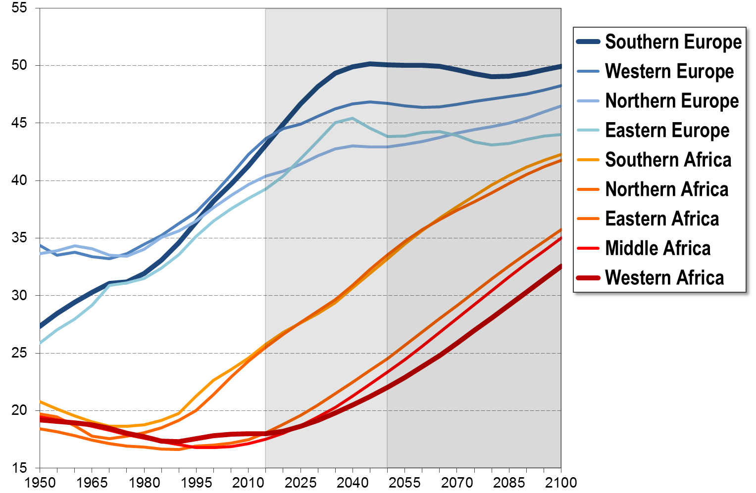
5
Africa - Europe: Median age, 1950-2100 (years)

Slide 37
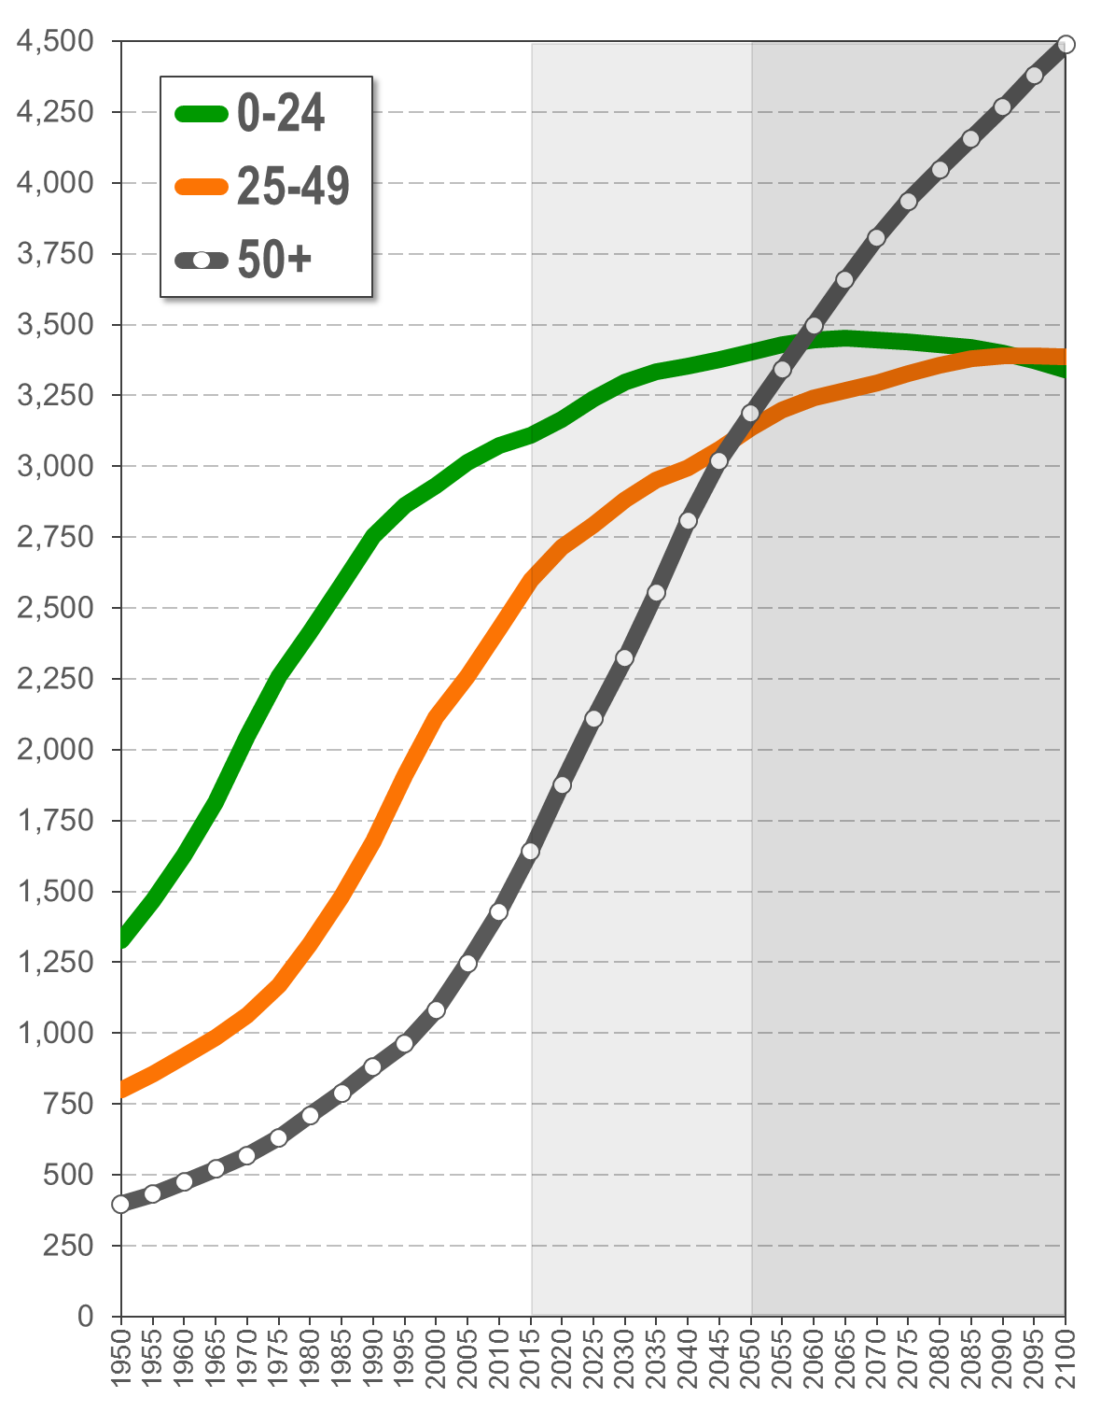
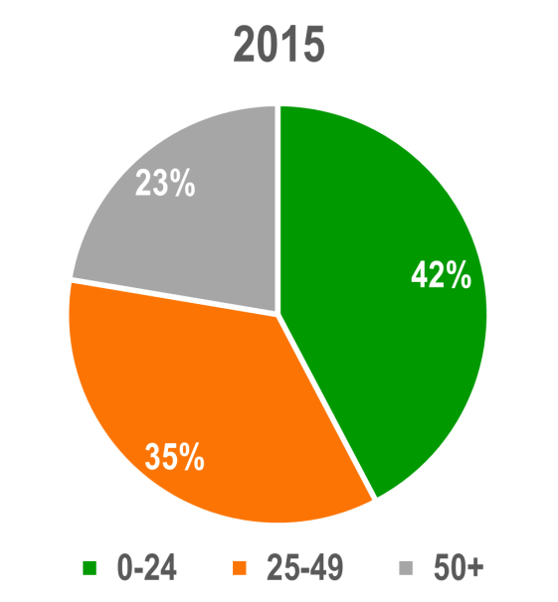
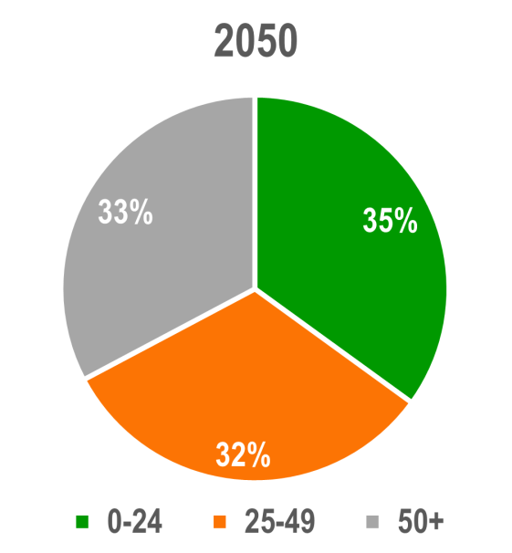
5
World: Population by age groups
Millions
Percent of total population
In 2050, 33% of all people worldwide will be age 50 or older.
Source: United Nations Department of Economic and Social Affairs, Population Division: World Population Prospects, the 2015 Revision. New York

Slide 38
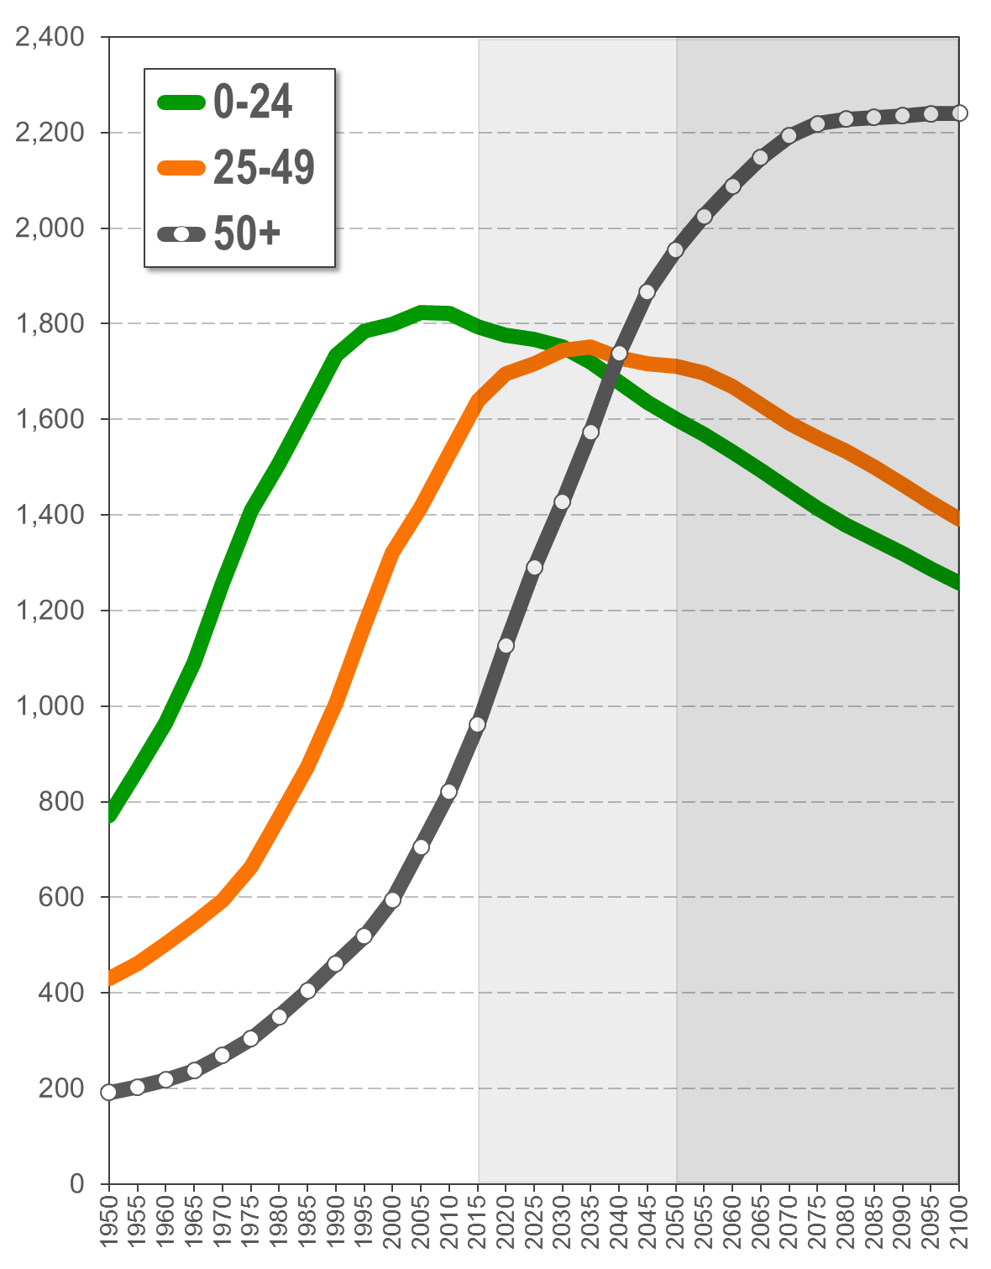

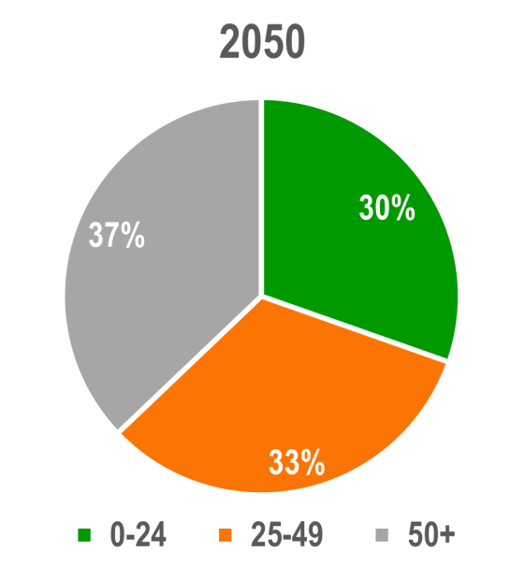
5
Asia: Population by age groups
Millions
Percent of total population
By the end of the century, Asia might have 2.2 billion people age 50 and above – 1 billion more than people under the age of 25.
Source: United Nations Department of Economic and Social Affairs, Population Division: World Population Prospects, the 2015 Revision. New York

Slide 39
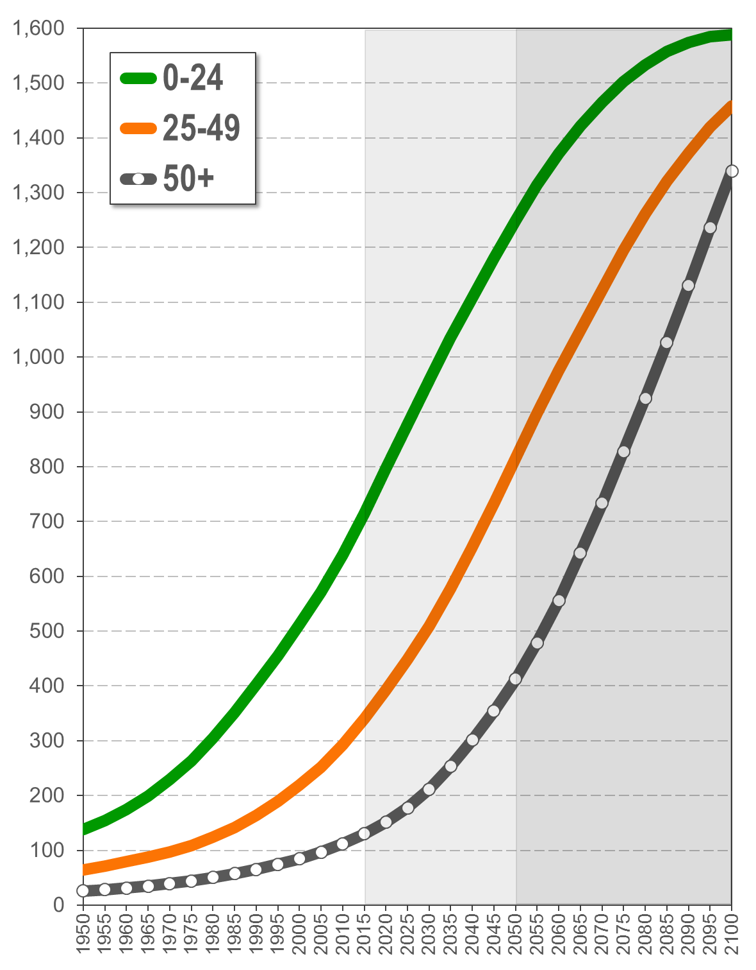
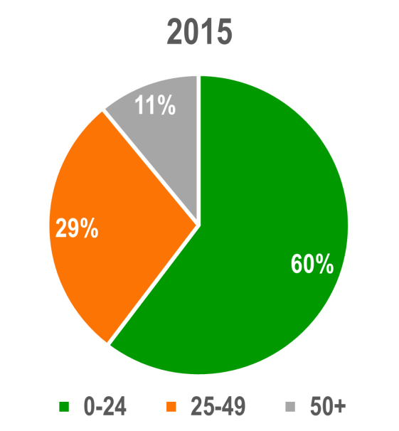
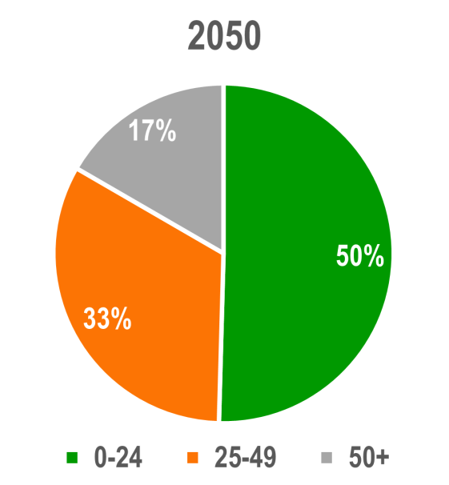
5
Africa: Population by age groups
Millions
Percent of total population
Today, 60% of Africa’s population are children and young adults under the age of 25.
Source: United Nations Department of Economic and Social Affairs, Population Division: World Population Prospects, the 2015 Revision. New York

Slide 40
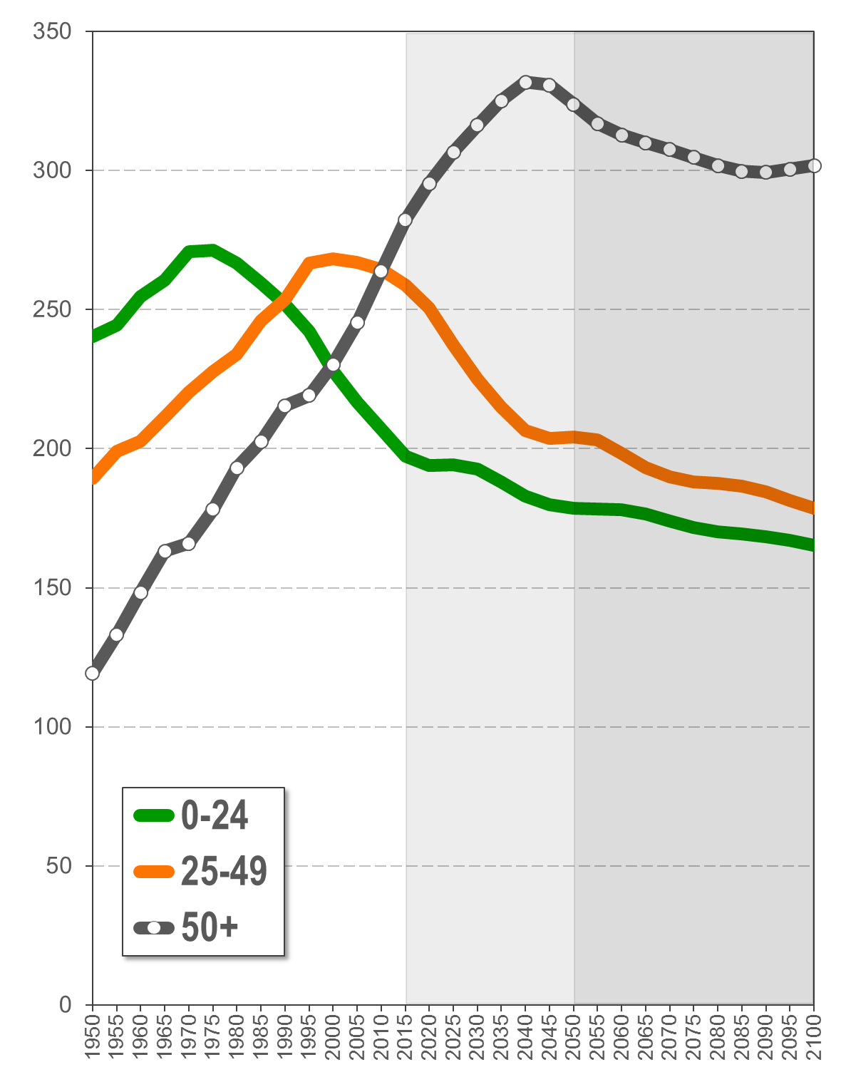
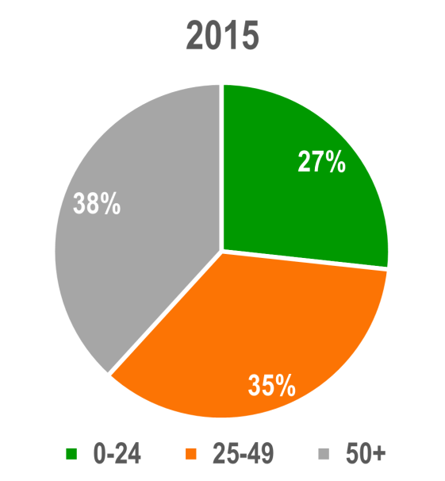
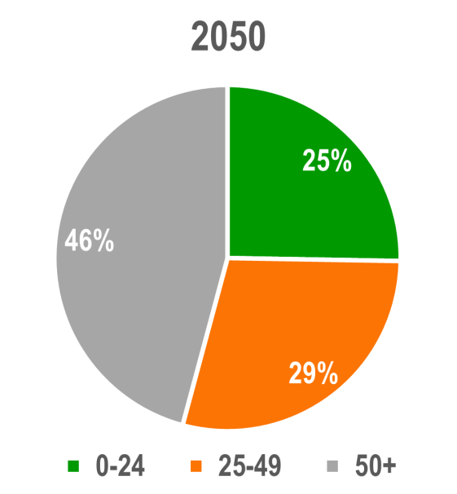
5
Europe: Population by age groups
Millions
Percent of total population
In 35 years, 46% of the European population will age 50 or above.
Source: United Nations Department of Economic and Social Affairs, Population Division: World Population Prospects, the 2015 Revision. New York

Slide 41
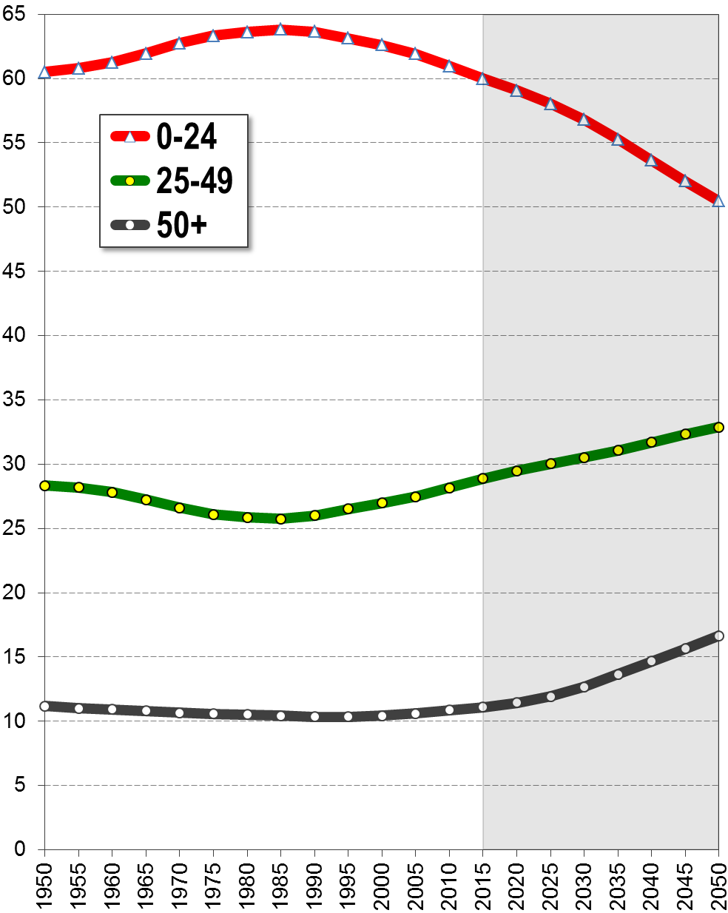
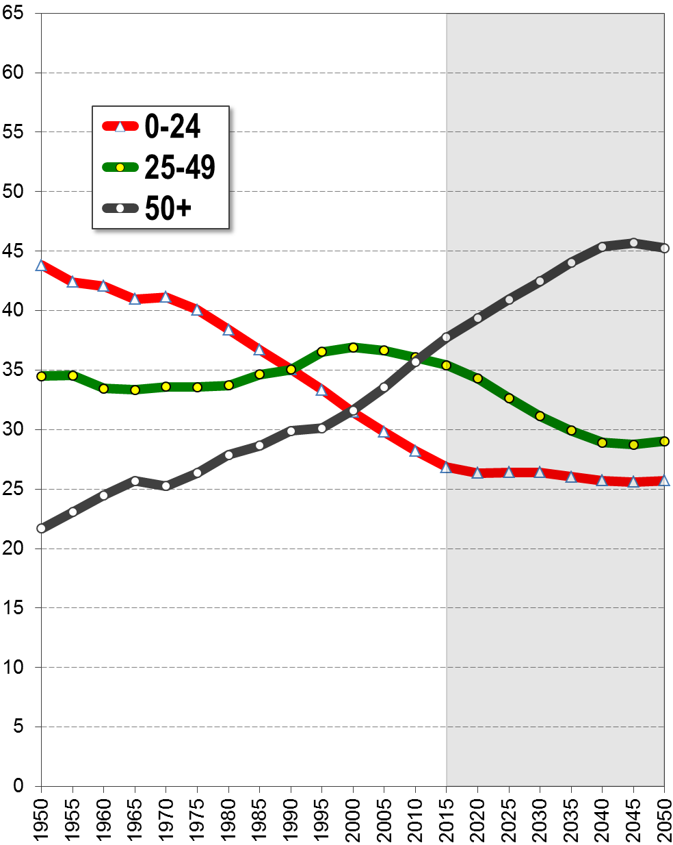
5
Population age structure
Population by age groups in percent of total population, 1950-2100
Africa
Europe
Europe’s “demographic window” has closed; high old-age dependency burden.

Slide 42
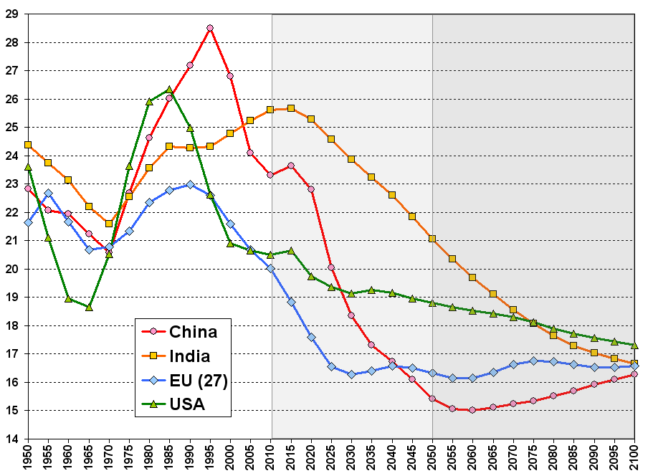
5
Prime working-age population(age 20-34 years)
Window
of economic
opportunity
percent of total population

Slide 43
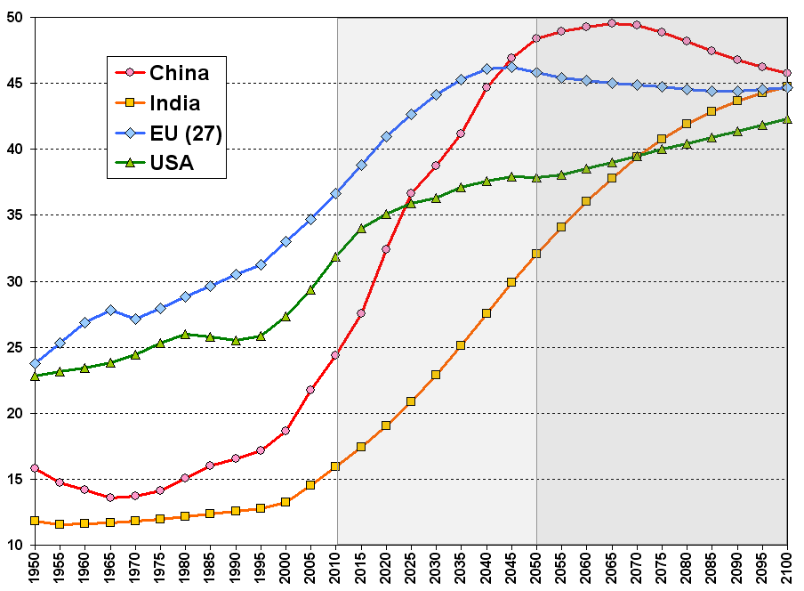
5
Population age 50+
percent of total population
Population
Ageing

Slide 44
World Population Prospects
6
Population dynamics:
Fertility & Mortality
Both in Africa and in Europe the current levels
of fertility are unsustainable. In Africa they cause a population explosion; in Europe the cause
population aging and decline.

Slide 45
6
The “demographic transition” model
The unprecedented increase in the world population did not happen because we were breeding like rabbits, but because
we were no longer dying like flies.

Slide 46
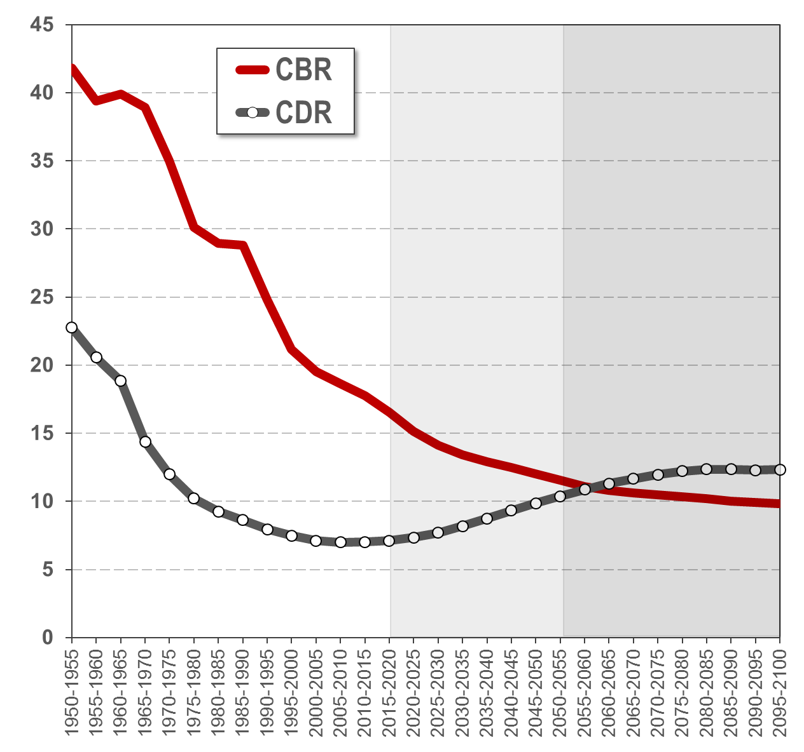
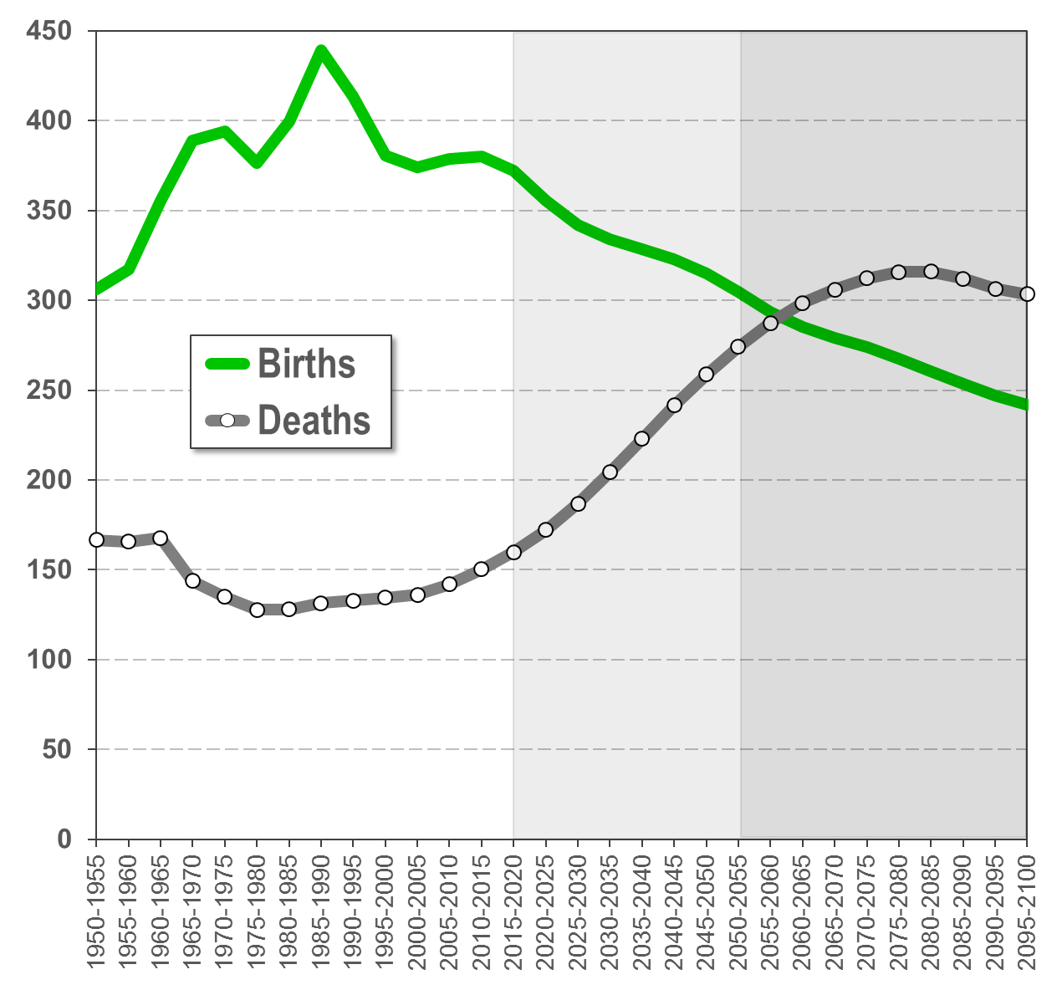
6
Asia: Birth rate, death rate / births, deaths
Declining birth rate – Declining number of births
Crude Birth Rate / Crude Death Rate
(births / deaths per 1000 of population)
Number of births and deaths
(in 1000)
Asia: Low crude birth rate + low crude death rate = but still population growth
Source: United Nations Department of Economic and Social Affairs, Population Division: World Population Prospects, the 2015 Revision. New York

Slide 47
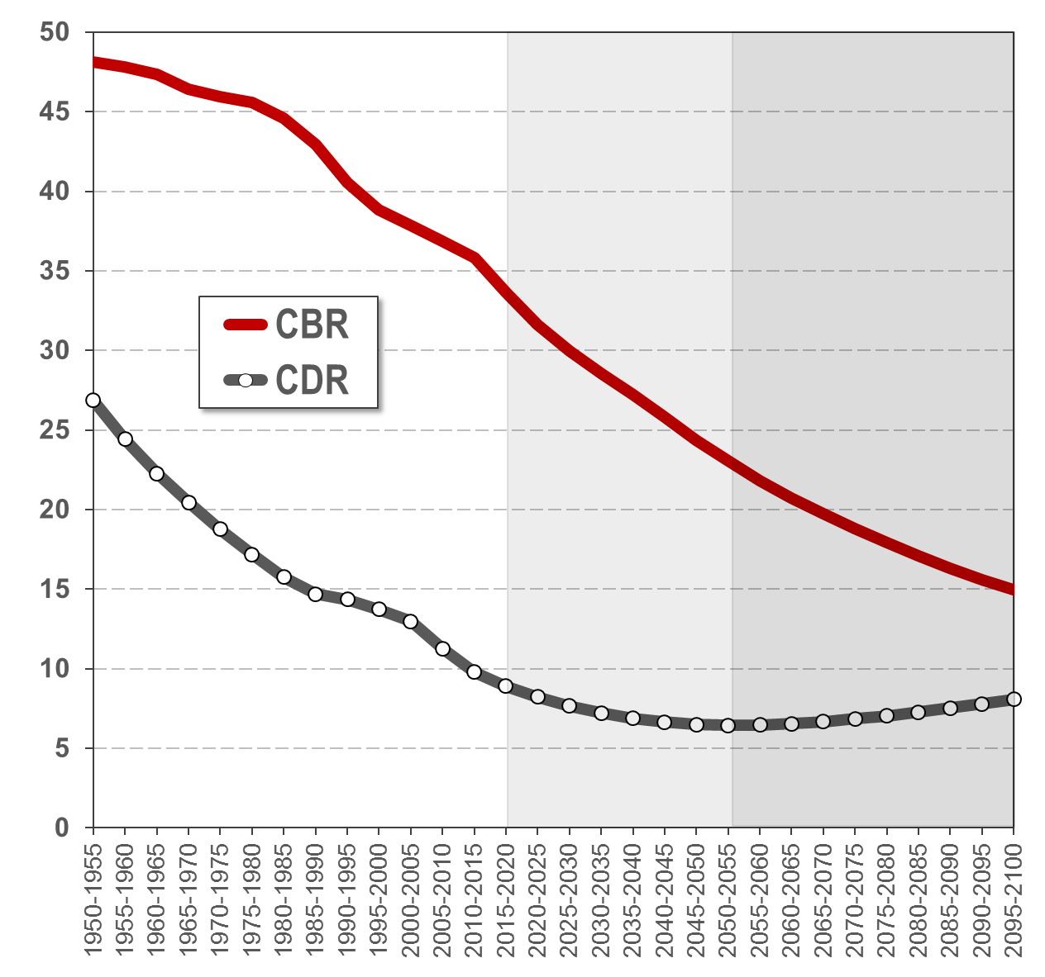
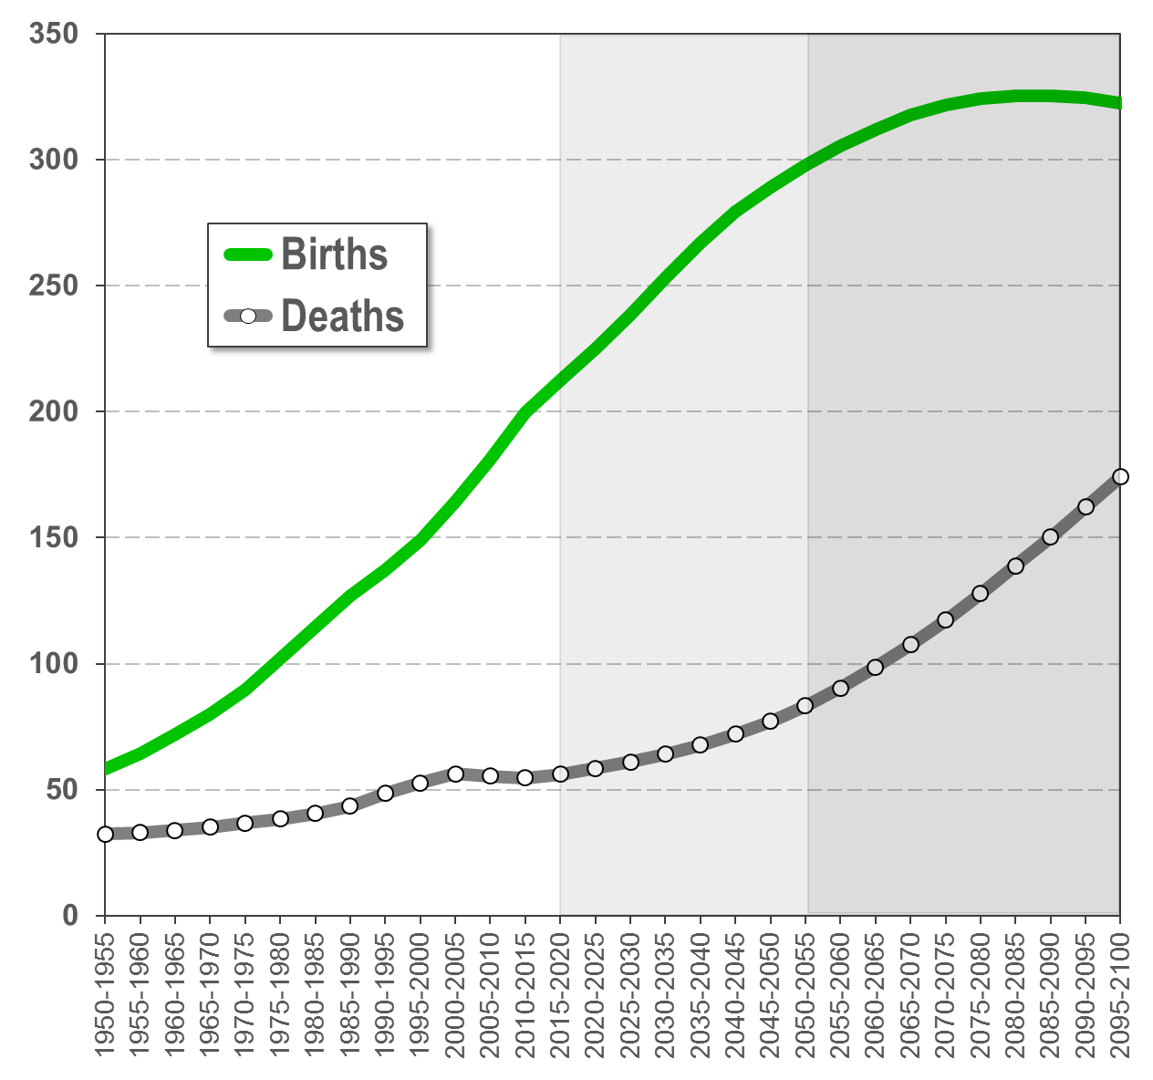
6
Africa: Birth rate, death rate / births, deaths
Declining birth rate – Rising number of births
Crude Birth Rate / Crude Death Rate
(births / deaths per 1000 of population)
Number of births and deaths
(in 1000)
Africa: High crude birth rate + low crude death rate = high population growth
Source: United Nations Department of Economic and Social Affairs, Population Division: World Population Prospects, the 2015 Revision. New York

Slide 48
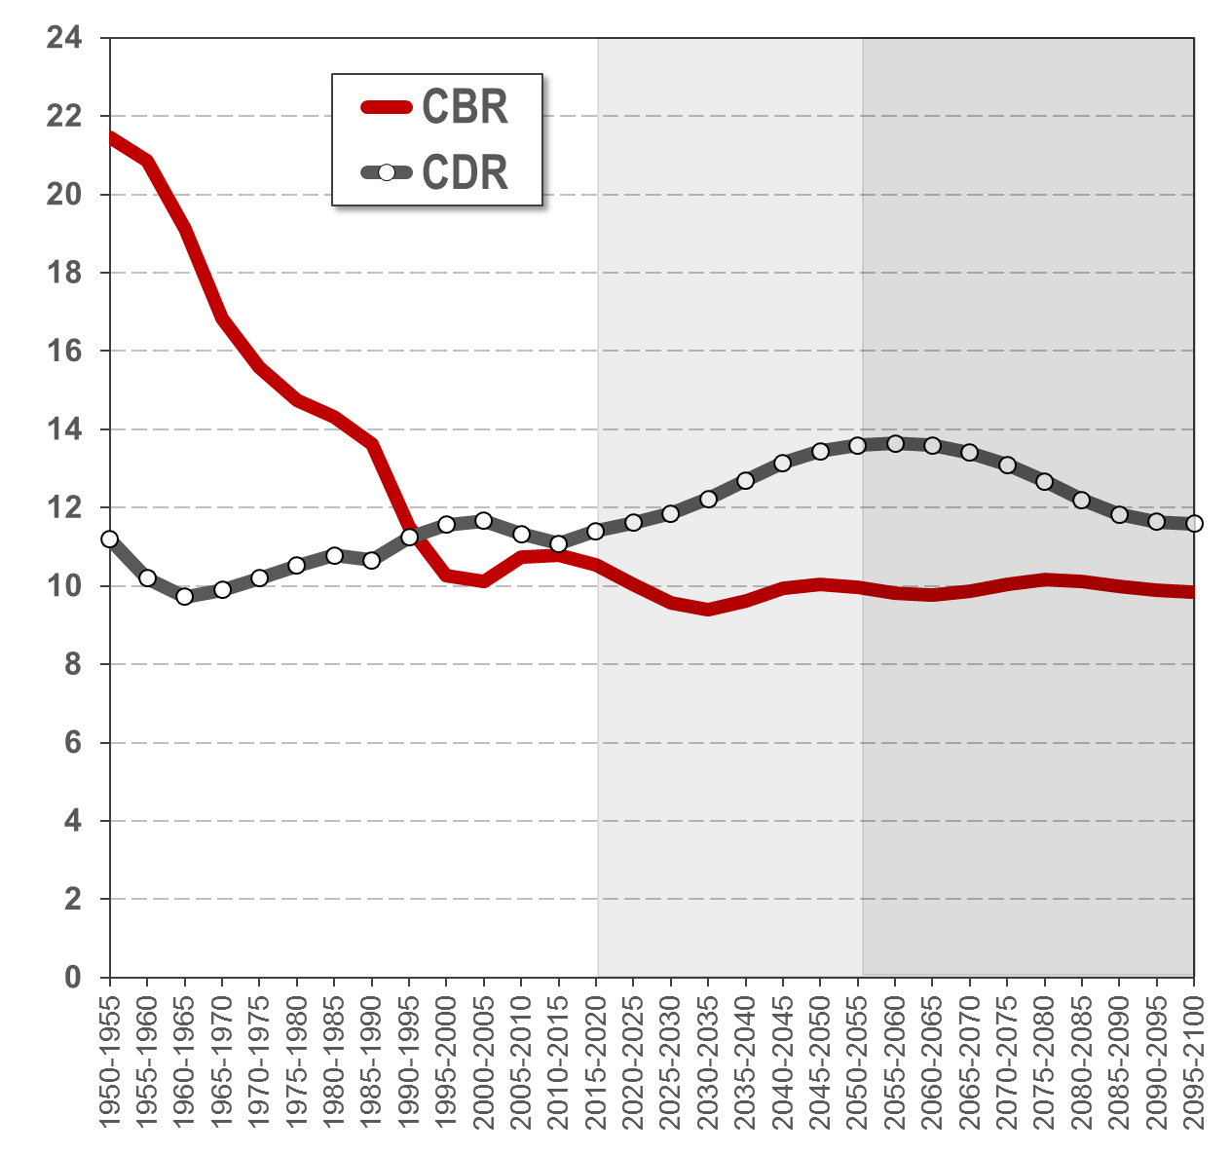
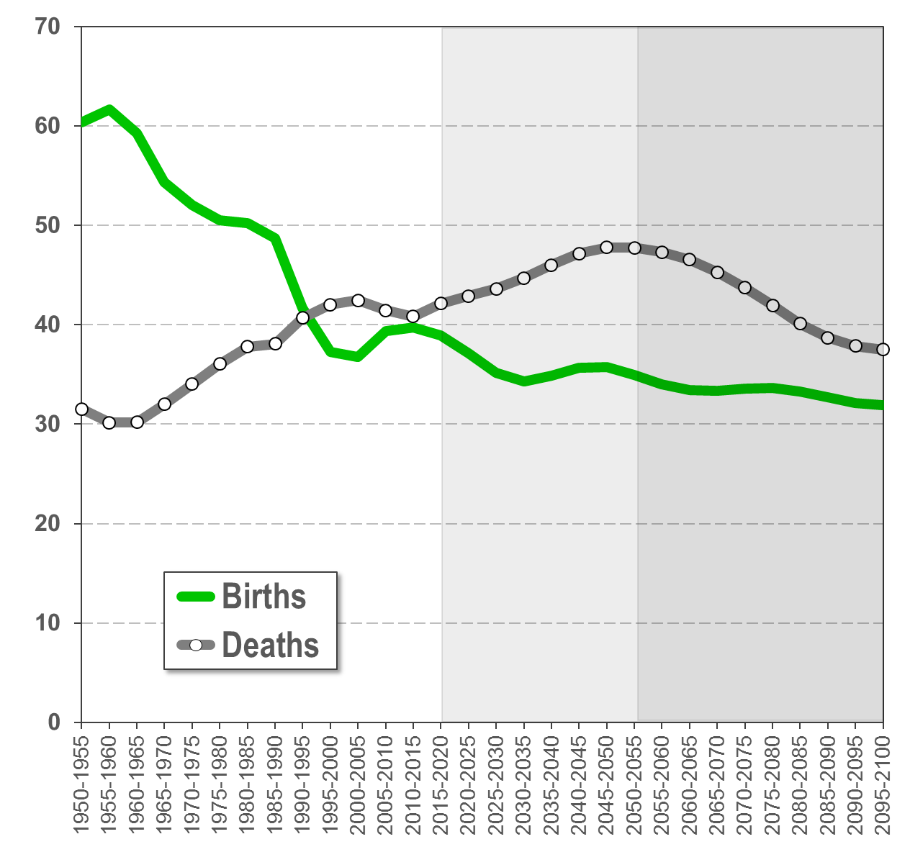
6
Europe: Birth rate, death rate / births, deaths
Death rate higher than birth rate – Slight population decline
Crude Birth Rate / Crude Death Rate
(births / deaths per 1000 of population)
Number of births and deaths
(in 1000)
Europe: Crude birth rate < crude death rate = population decline
Source: United Nations Department of Economic and Social Affairs, Population Division: World Population Prospects, the 2015 Revision. New York

Slide 49


6
Northern America: Birth rate, death rate / births, deaths
Birth rate higher than death rate – Population increase
Crude Birth Rate / Crude Death Rate
(births / deaths per 1000 of population)
Number of births and deaths
(in 1000)
Northern America: Crude birth rate > crude death rate = population growth
Source: United Nations Department of Economic and Social Affairs, Population Division: World Population Prospects, the 2015 Revision. New York

Slide 50
6
Distribution of births by major area
Note: Bubble size is relative to the absolute number of births, with numbers referring to the interpolated annual number of births (thousands)
Source: United Nations Department of Economic and Social Affairs, Population Division: World Fertility Patterns, 2013 (based on the 2012 Revision). New York

Slide 51

6
Net-Reproduction-Rate: Selected regions
Number of daughters per women
1.94
0.97
0.90
0.76
Source: United Nations Department of Economic and Social Affairs, Population Division: World Population Prospects, the 2015 Revision. New York

Slide 52
6
Net-Reproduction-Rate: Selected regions
Africa: Population is almost doubling between generations
1.94
Asia: Population is shrinking by 3% between generations
0.97
Northern America: Pop. is shrinking by 10% between generation
0.90
Europe: Population is shrinking by 24% between generations
0.76
The Net-Reproduction-Rate is the average number of daughters that female members of a birth cohort would bear during their reproductive life span if they were subject throughout their lives to the observed age-specific fertility and mortality rates of the given time period.
The NRR is expressed as the number of daughters per woman.

Slide 53




6
Net-Reproduction-Rates: All countries
1950
195 countries NRR > 1
2015
119 countries NRR > 1
2050
65 countries NRR > 1
2100
23 countries NRR > 1

Slide 54

6
World population by level of fertility (TFR)

Slide 55

1
World in 2100: 2012, 2015 & 2017 Revisions (billion)
Source: United Nations Department of Economic and Social Affairs, Population Division: World Population Prospects, the 2015 and 2917 Revision. New York

Slide 56
Thank you!
For more details and in-depth analyses go to:
www.demographics.at

Slide 57
Disclaimer
This presentation is not a United Nations publication.
It is a private project, authored by Gerhard K. Heilig. Views expressed are those of
the author and do not imply the expression of any opinion on the part of any international organization or research institute.
This presentation is using data from the official United Nations “World Population Prospects” (WPP), the “World Urbanization Prospects” (WUP) and the “Probabilistic Population Projections” (PPP) for all countries of the world, as published by the
United Nations Population Division of the Department of Economic and Social Affairs.
The official data are available on the following official websites:
For the World Population Prospects: http://esa.un.org/unpd/wpp/
For the World Urbanization Prospects: http://esa.un.org/unpd/wup/
For the Probabilistic Population Projections: http://esa.un.org/unpd/DVD/

Slide 58

Copyright
I, the copyright holder of this work, hereby publish it under the following licenses:
This file is licensed under the Creative Commons Attribution-Share Alike 3.0 Unported license.
You are free:
to share – to copy, distribute and transmit the work
to remix – to adapt the work
Under the following conditions:
attribution – You must attribute the work in the manner specified below (but not in any way that suggests that I endorse you or your use of the work).
share alike – If you alter, transform, or build upon this work, you may distribute the resulting work only under the same or similar license to this one.
I, the copyright holder, request that you attribute this work as:
“UN World Population Prospects, the 2015 Revision. PowerPoint presentation by Gerhard K. Heilig, 7 September, 2015 (www.gerhard-k-heilig.com)”

