Slide 1

Long-range Population Scenarios
Gerhard K. Heilig
Presentation prepared for the “High-level Workshop on Management of Natural Resources from
the Perspective of Sustainable Development III” of the
Forschungszentrum Jülich - organized in Bonn, Germany on September 12, 2017
Universitätsclub Bonn e.V., Konviktstr. 9, 53113 Bonn
Contact:
Gerhard K. Heilig, Waldheimstrasse 29, 3004 Riederberg, Austria
e-mail: gerhard.heilig@gmail.com; website: www.gerhard-k-heilig.com
Disclaimer: This PowerPoint presentation is not a United Nations publication. Views expressed are my own and do not imply the expression of any opinion on the
part of any international organization or research institute. However, this presentation is using data from the official United Nations World Population Prospects,
the World Urbanization Prospects and the Probabilistic Population Projections for all countries of the world.

Slide 2
Long-range Population Scenarios
Content
1
UN Population Scenarios: 2000-2300
Conceptual Models
To be expected: Urbanization
To be expected: Population Aging
Possible Demographic Disruptions
Conclusions & Predictions
2
3
4
5
6

Slide 3
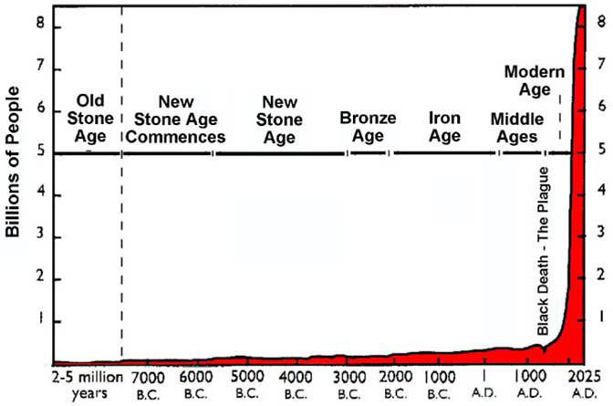
1
Modern “Population Explosion”
Scale would have to be extended by 492 feet (150 m)
to correctly represent world population growth.

Slide 4
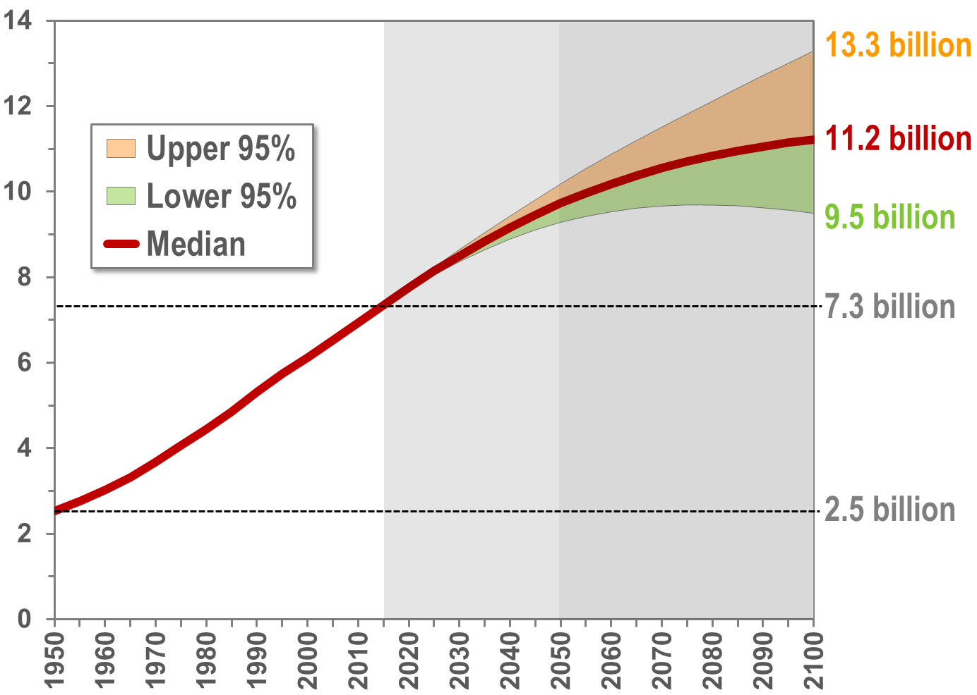
1
World: Population, 1950-2100 (billion)
9.7
Source: United Nations Department of Economic and Social Affairs, Population Division: World Population Prospects, the 2015 Revision. New York

Slide 5
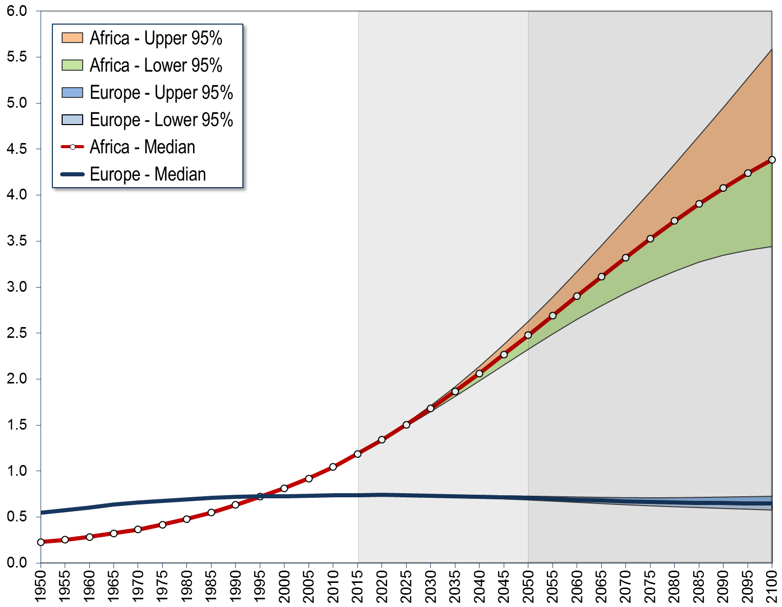
1
Africa - Europe: Population, 1950-2100 (million)
4,387
2,478
1,186
549
738
707
646
229
Source: United Nations Department of Economic and Social Affairs, Population Division: World Population Prospects, the 2015 Revision. New York

Slide 6
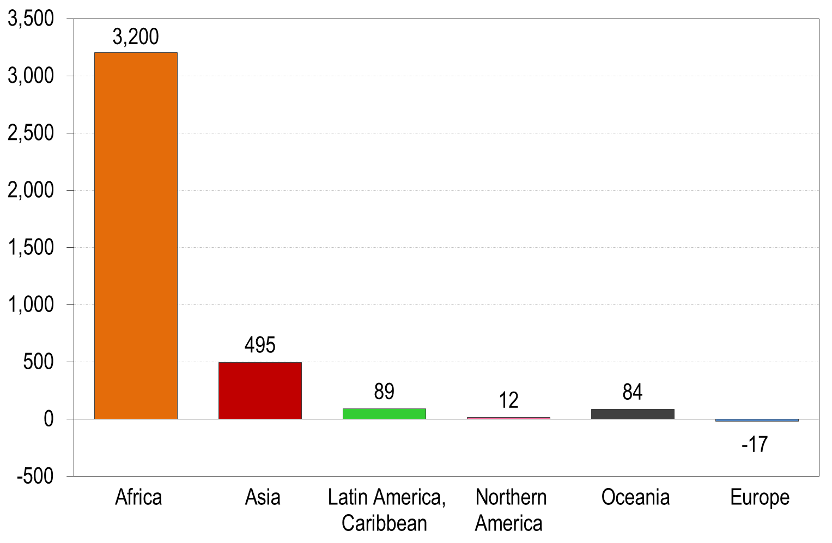
1
Population growth or decline, 2015-2100 (millions)
Source: United Nations Department of Economic and Social Affairs, Population Division: World Population Prospects, the 2015 Revision. New York

Slide 7
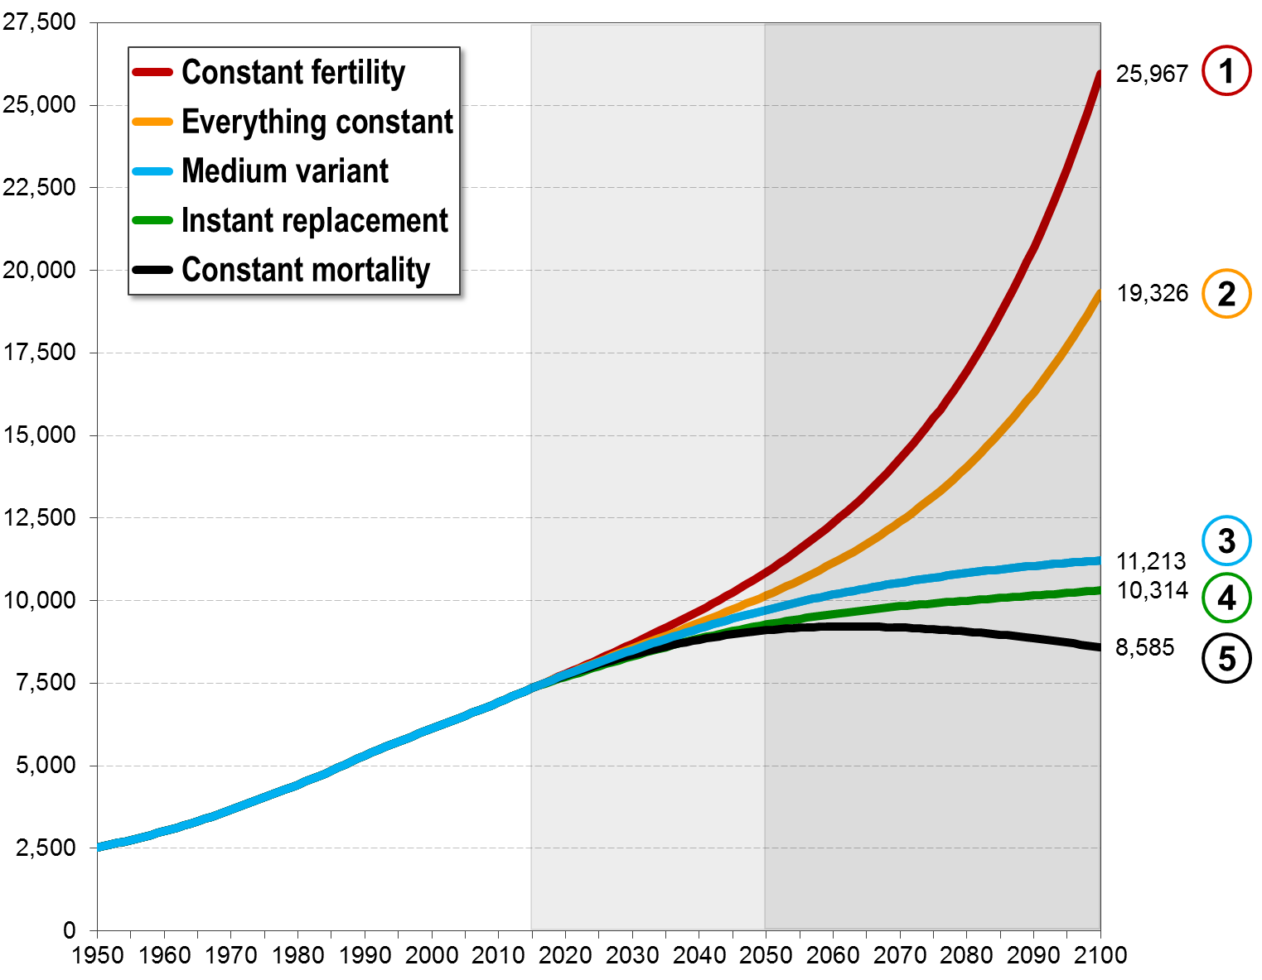
1
Global projections by variant: 1950-2100 (million)
Constant fertility and
mortality decline: 25 billion
Constant fertility and
const. mortality: 19 billion
Medium variant:
11 billion
Instant replacement
fertility: 10 billion
Constant mortality:
8.6 billion
Source: United Nations Department of Economic and Social Affairs, Population Division: World Population Prospects, the 2015 Revision. New York

Slide 8
1
World population in 2100 by scenario
Constant-fertility
  With current fertility (and medium-variant mortality decline) the world population would increase to 25 billion people.
Everything constant
  With current fertility and mortality the world population would increase to only some 19 billion, because fewer people would survive to old age
Medium variant (= median of probabilistic projections)
  With declining fertility and declining mortality the world population would increase to 11.2 billion.
Instant-replacement-fertility
  Even if all high-fertility countries would reduce their fertility to replacement, the global population would grow to 10.3 billion
Constant-mortality
  With current mortality (and medium-variant fertility decline) the world population would be only 8.6 billion.
Source: WPP2015

Slide 9
Long-range Population Scenarios
1
World population in 2300
Based on: United Nations, Department of
Economicand Social Affairs, Population Division:
World Population in 2300. Highlights.
New York, 2003 (ESA/P/WP.187)

Slide 10
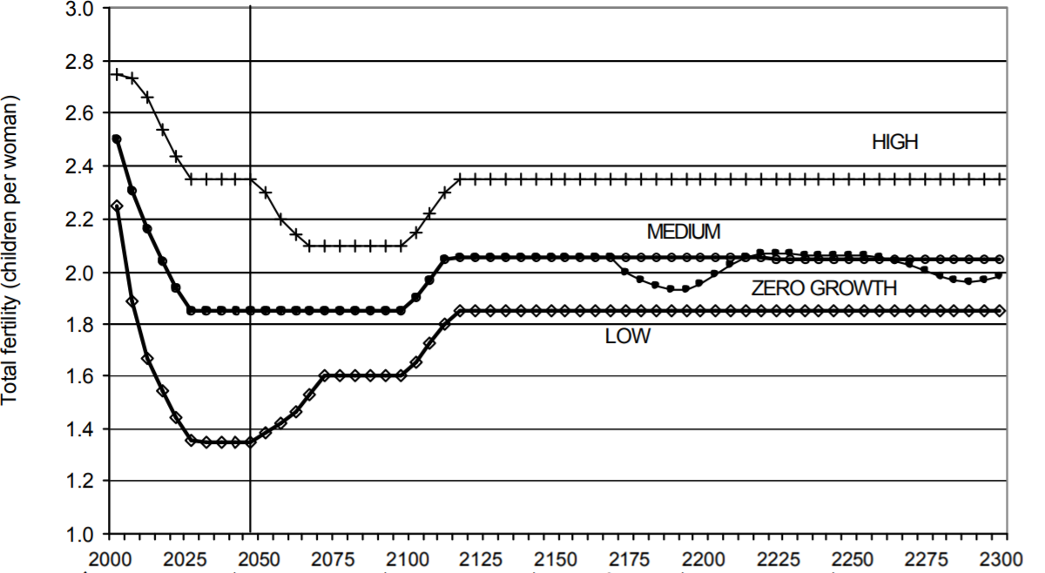
1
Fertility assumptions: TFR
wpp2002
2.35
2.05
1.85
Period of „sub-replacement“ Fertility
Source: United Nations Department of Economic and Social Affairs, Population Division: World Population Prospects, the 2015 and 2917 Revision. New York

Slide 11
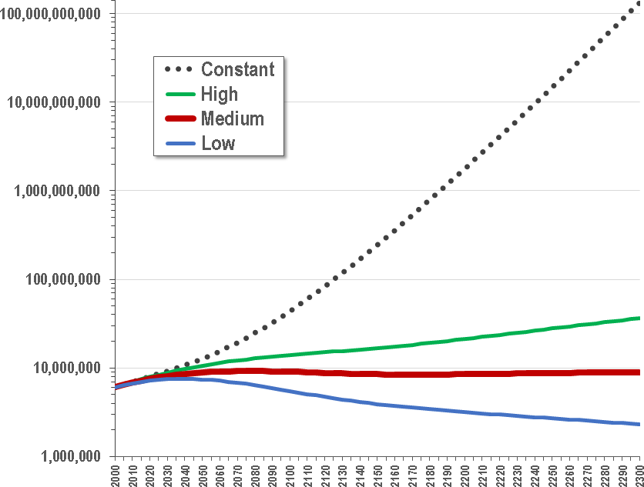
1
World population by scenario, 2000-2300 (billion)
133.6
36.4
8.3
2.3
Source: United Nations Department of Economic and Social Affairs, Population Division: World Population Prospects, the 2015 and 2917 Revision. New York

Slide 12
Africa: Impossibility of current conditions
If fertility remained completely stalled around the current fertility level of 5.0 already in 2100, the population size of Sub-Saharan Africa would reach a stunning
12 billion and a sheer impossible
355 billion by 2200.
Stuart Basten, Wolfgang Lutz & Sergei Scherbov (2013).
Very long range global population scenarios to 2300 and the implications of sustained
low fertility. DEMOGRAPHIC RESEARCH,VOLUME 28, ARTICLE 39, PAGES 1145-1166
PUBLISHED 30 MAY 2013

Slide 13
1
Conclusions
Component | Trends
Fertility | All countries will have lengthy periods of below-replacement fertility
 | Great variability between countries in timing when below-replacement fertility will start
 | Half-a-child difference in fertility accounts for the difference in world population between 2.3 billion and 36.4 billion
 | If fertility returns to replacement - after a 100 year period of below-replacement fertility - world population could be 9 billion in 2300.
 | If one would NOT assume that fertility declines everywhere, the world population would explode to far greater population than 36.4 billion
Mortality | Life expectancy will increase continuously, boosting pop. size
 | Number of centenarians will increase to 162 million
Pop. Structure | Population ageing is unavoidable (because fertility must fall)
Source: United Nations Department of Economic and Social Affairs, Population Division: World Population Prospects, the 2015 Revision. New York

Slide 14
Long-range Population Scenarios
2
Conceptual Models
The demographic history since 1900
will NOT repeat itself. It is numerically impossible.
World population growth is not over.
Catastrophic events are possible.

Slide 15
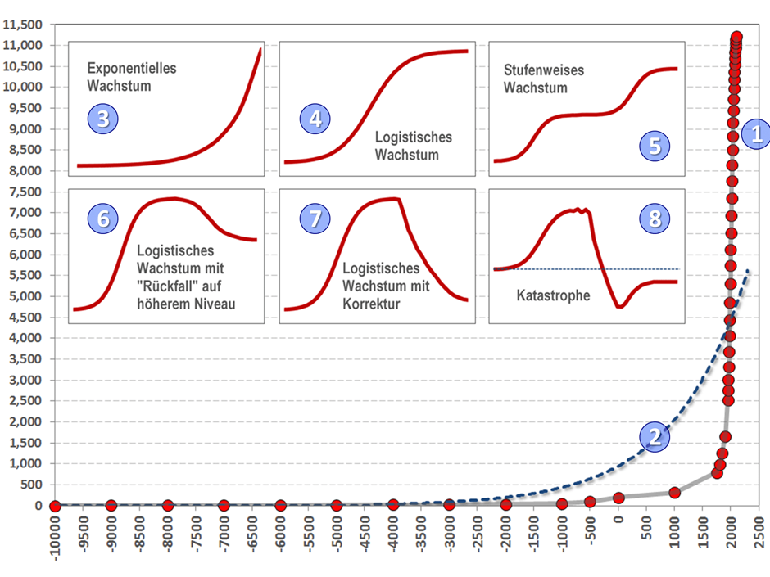
2
Models: Long-range Population Scenarios

Slide 16
2
Model Implications
Model | Long-term Implications
 | Current situation. Completely impossible – even in short-term future
 | Historical development was NOT exponential.
 | Exponential growth. Impossible – even in short-term future
 | Logistic. Possible
 | Stepwise. Possible
 | Logistic + high plateau. Possible
 | Logistic + low plateau after correction. Possible, with crisis (environment)
 | Logistic + crash. Possible, with catastrophic event (global nuclear war)
1
2
3
4
5
6
7
8
Source: United Nations Department of Economic and Social Affairs, Population Division: World Population Prospects, the 2015 Revision. New York

Slide 17
2
Models: Malthusian Catastrophe
Assumption, that the population by the end of
the 21st century is unsustainable and will be corrected to some 2 to 3 billion by various constraints

Slide 18
2
Models: Demographic Singularity
Assumption, that the population by the end of the 21st century is sustainable with advanced technology.
A new 10-15 billion world
will emerge

Slide 19
2
Models: Doomsday / “Nuclear Winter”
Assumption, that the population by the end of
the 21st century is unsustainable and will be corrected to some 2 to 3 billion by various constraints

Slide 20
Long-range Population Scenarios
3
Urbanization
Almost all future population growth will be in
urban areas – often by expansion of slums.
If world population increases beyond 10 billion, cities will
be without alternative, because rural areas will be needed
to provide food, resources, energy and environmental
services (water, climate)

Slide 21
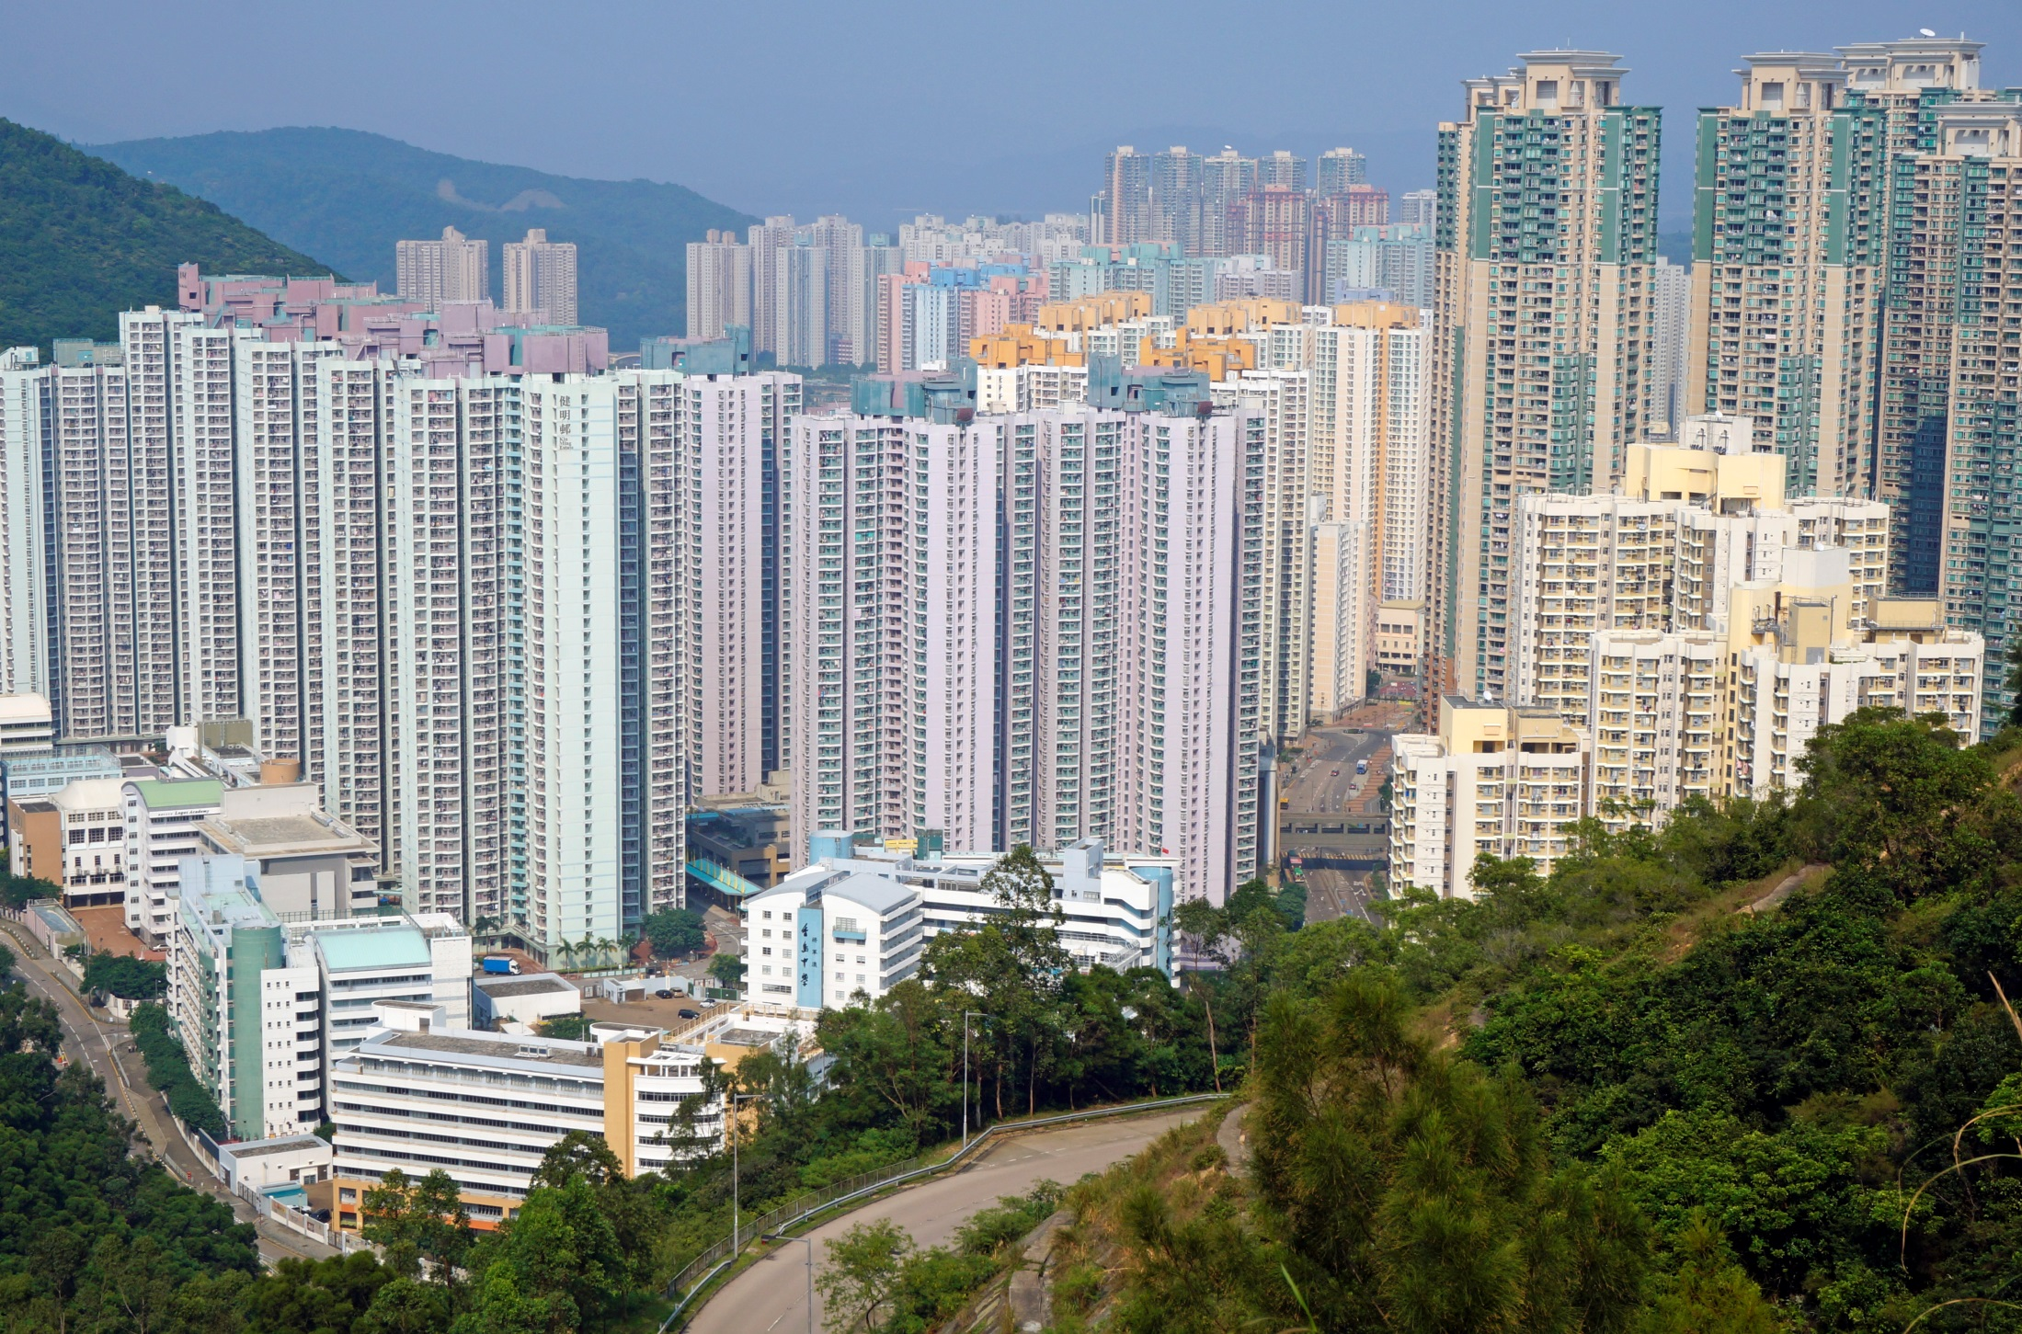
3
Asia: Urban quality of life?
"Kin Ming Estate 2013 10 part2" by Qwer132477 - Own work. Licensed under CC BY-SA 3.0 via Wikimedia Commons - https://commons.wikimedia.org/wiki/File:Kin_Ming_Estate_2013_10_part2.JPG#/media/File:Kin_Ming_Estate_2013_10_part2.JPG

Slide 22
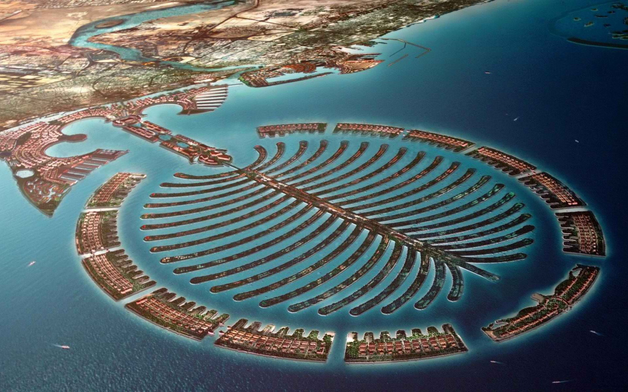
3
Dream city of the future – or urban nightmare?
"Kin Ming Estate 2013 10 part2" by Qwer132477 - Own work. Licensed under CC BY-SA 3.0 via Wikimedia Commons - https://commons.wikimedia.org/wiki/File:Kin_Ming_Estate_2013_10_part2.JPG#/media/File:Kin_Ming_Estate_2013_10_part2.JPG

Slide 23
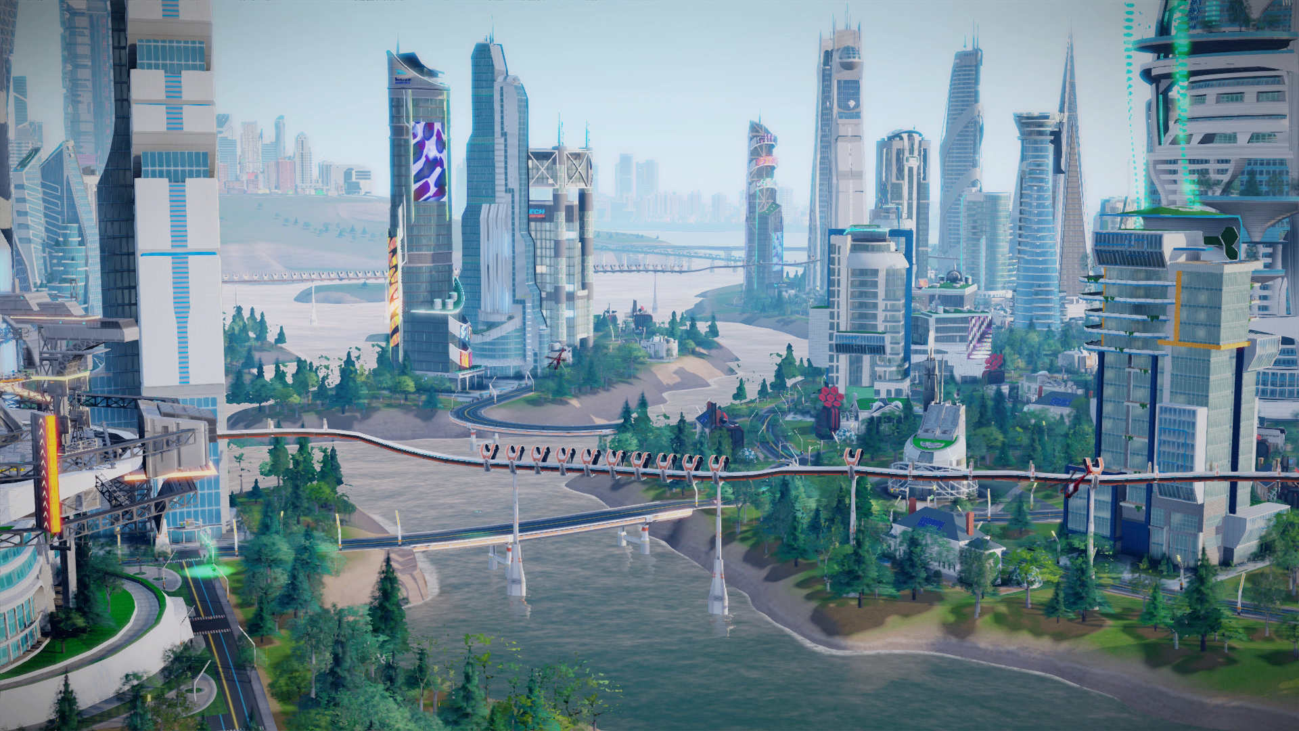
3
Dream city of the future – or urban nightmare?
"Kin Ming Estate 2013 10 part2" by Qwer132477 - Own work. Licensed under CC BY-SA 3.0 via Wikimedia Commons - https://commons.wikimedia.org/wiki/File:Kin_Ming_Estate_2013_10_part2.JPG#/media/File:Kin_Ming_Estate_2013_10_part2.JPG

Slide 24
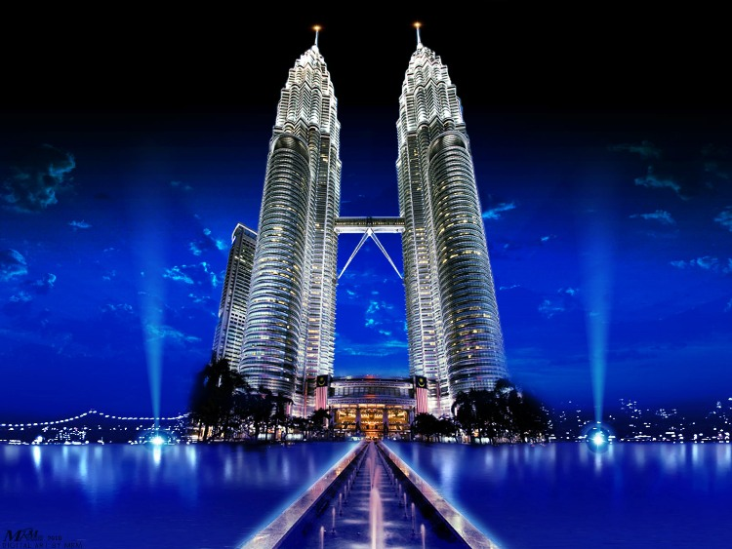
3
Dream city of the future – or urban nightmare?
"Kin Ming Estate 2013 10 part2" by Qwer132477 - Own work. Licensed under CC BY-SA 3.0 via Wikimedia Commons - https://commons.wikimedia.org/wiki/File:Kin_Ming_Estate_2013_10_part2.JPG#/media/File:Kin_Ming_Estate_2013_10_part2.JPG
Petronas Towers, Malaysia

Slide 25
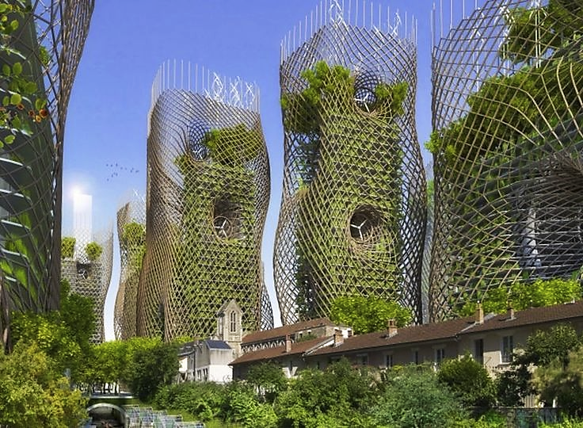
3
Dream city of the future – or urban nightmare?
"Kin Ming Estate 2013 10 part2" by Qwer132477 - Own work. Licensed under CC BY-SA 3.0 via Wikimedia Commons - https://commons.wikimedia.org/wiki/File:Kin_Ming_Estate_2013_10_part2.JPG#/media/File:Kin_Ming_Estate_2013_10_part2.JPG

Slide 26
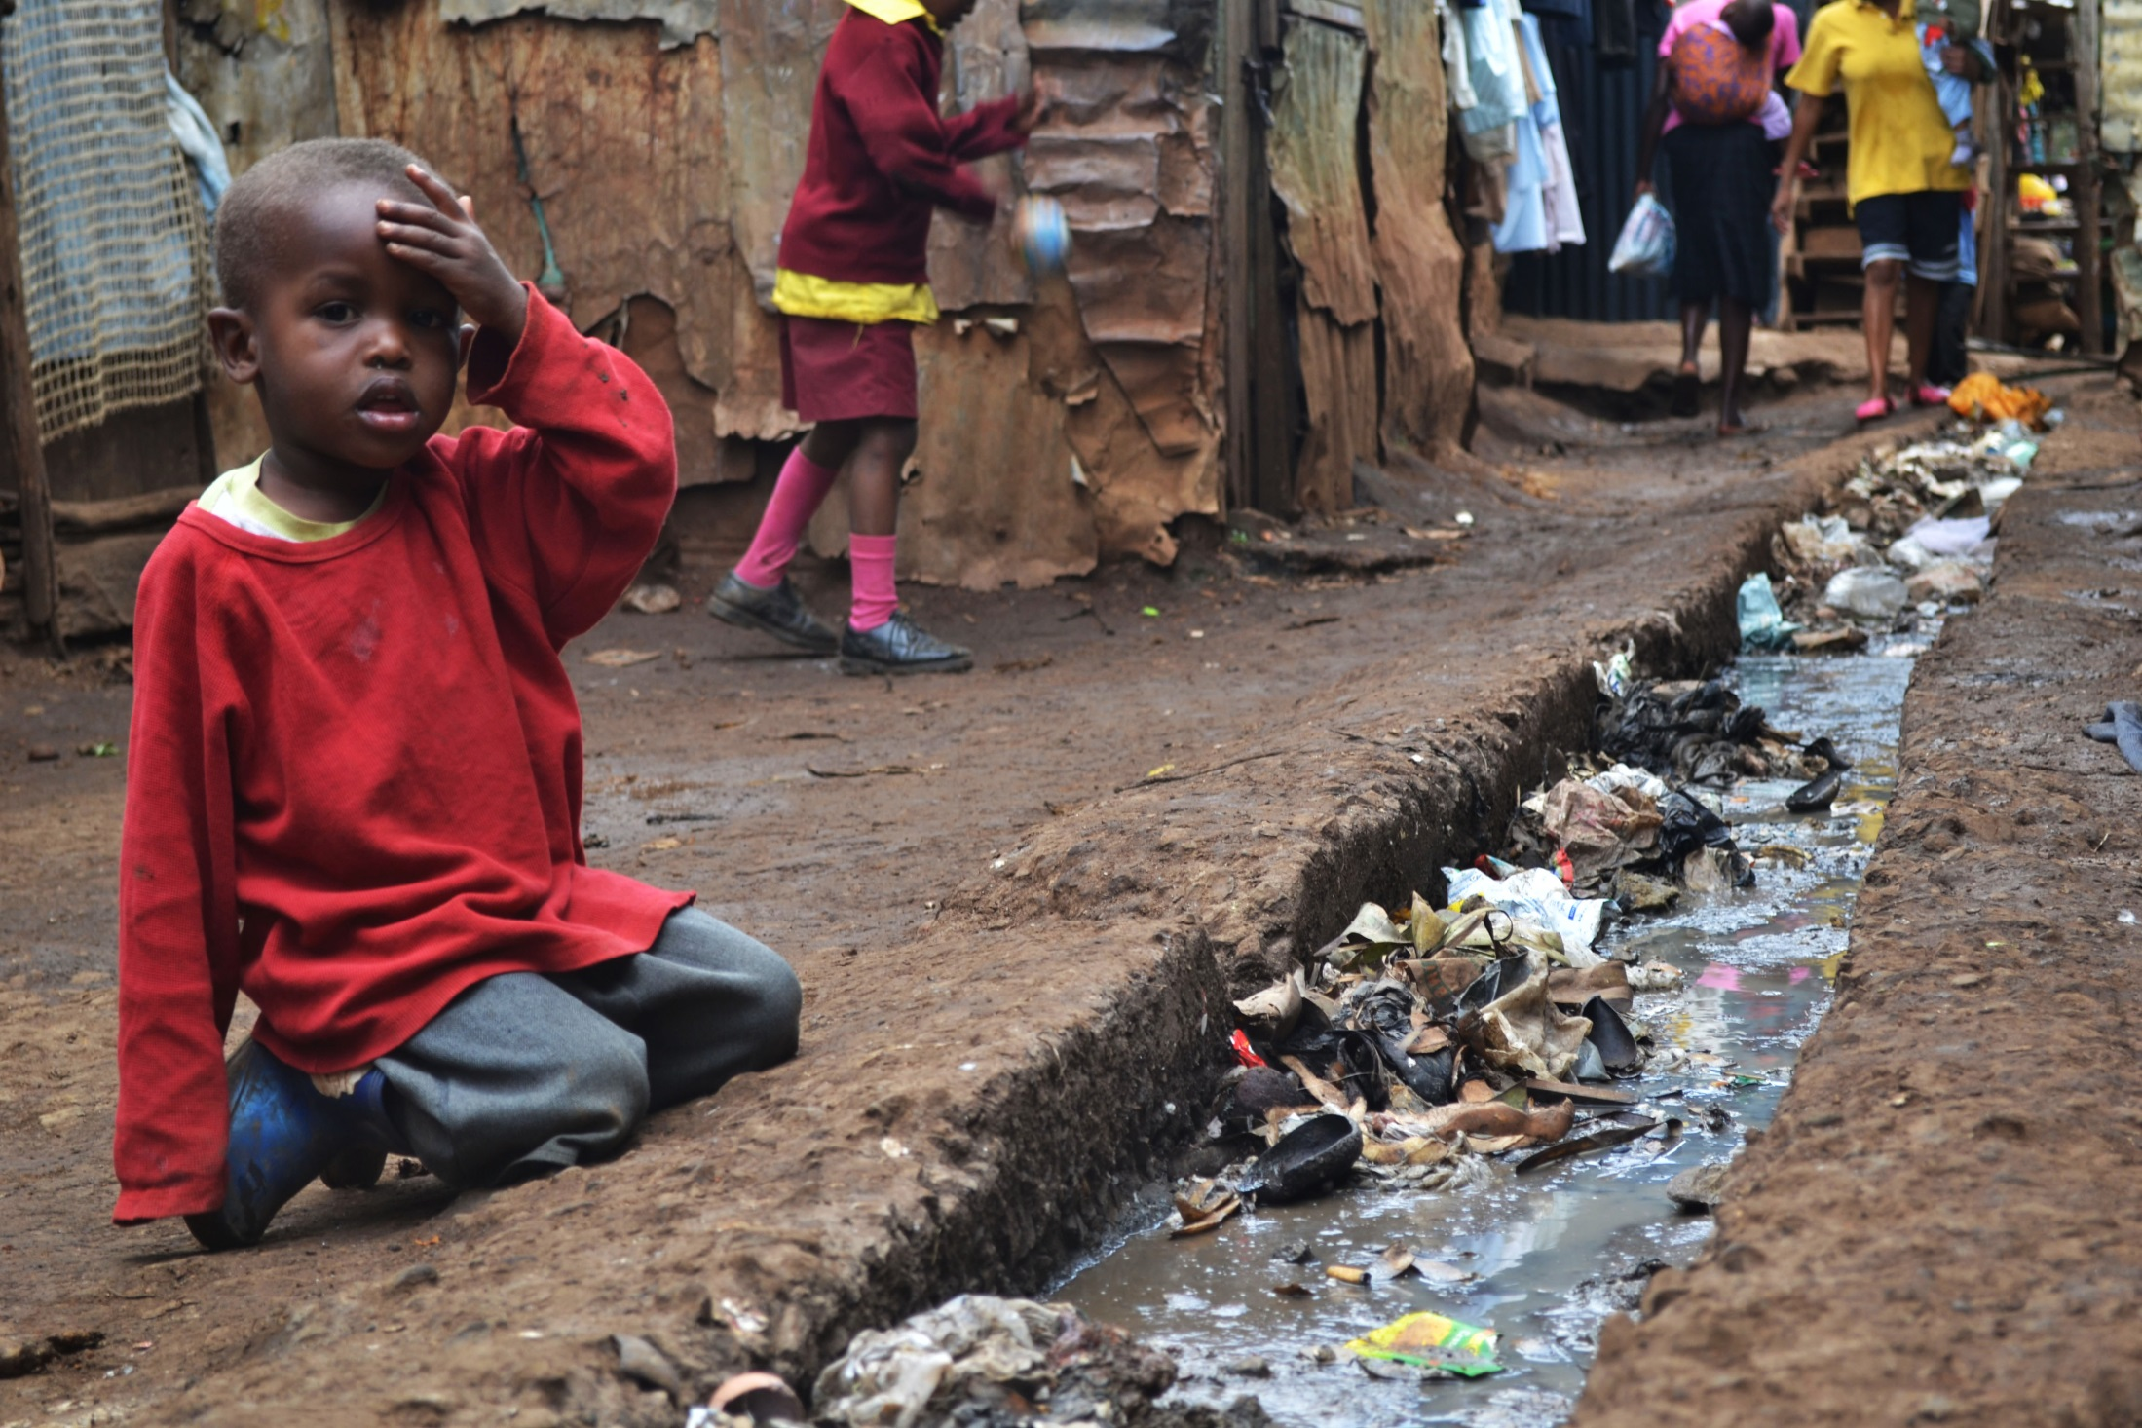
3
Africa: Kibera – Slum, Nairobi
A young boy sits over an open sewer in the Kibera slum, Nairobi. Photo by Trocaire. Licensed under CC BY 2.0 via Wikimedia Commons.

Slide 27
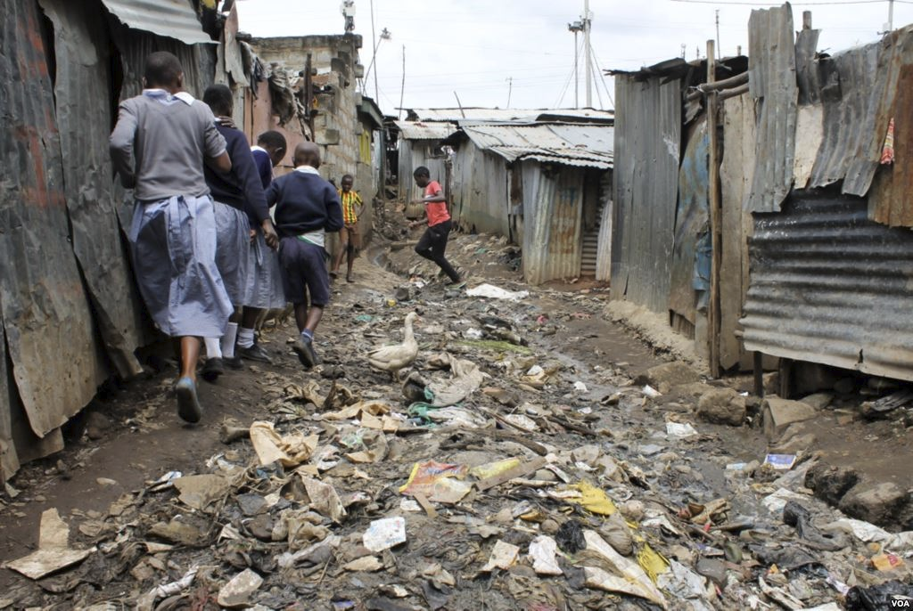
3
Africa, Kenya: Slum
Health Situation in Kisumu Slums.

Slide 28
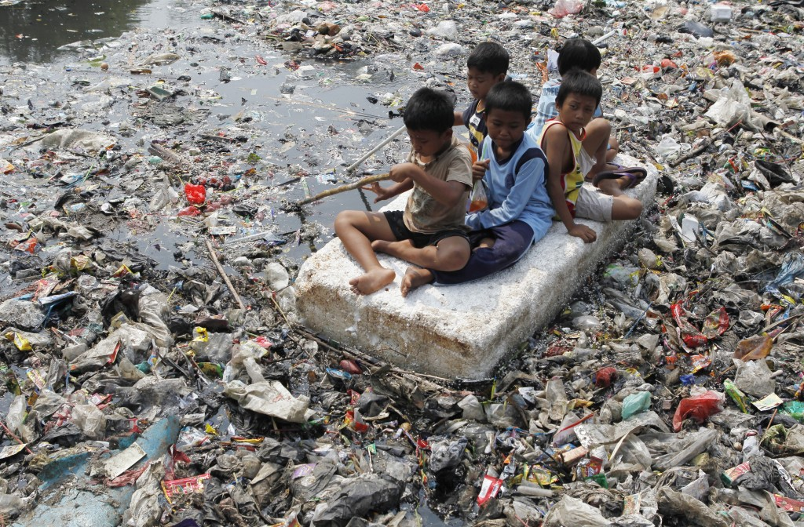
3
Indonesia, Jakarta
Children sitting on a makeshift raft play in a river full of rubbish in a slum area of Jakarta, Indonesia, in 2012. Photo by Enny Nuraheni/Reuters

Slide 29
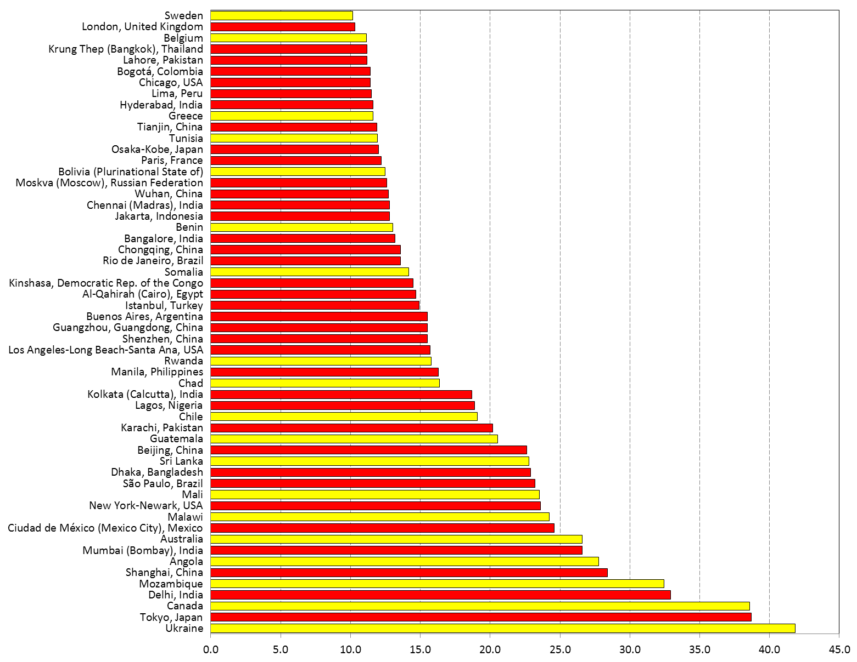
3
Mega-Cities und selected countries (in 2025)
Somalia
Cairo
Lagos
Chile
Mozambique
Delhi

Slide 30
Long-range Population Scenarios
4
Population aging
If we want to avoid a world population of
far more than 11 billion, population aging is
also unavoidable, because it is (primarily) a
consequence of rapid fertility decline

Slide 31
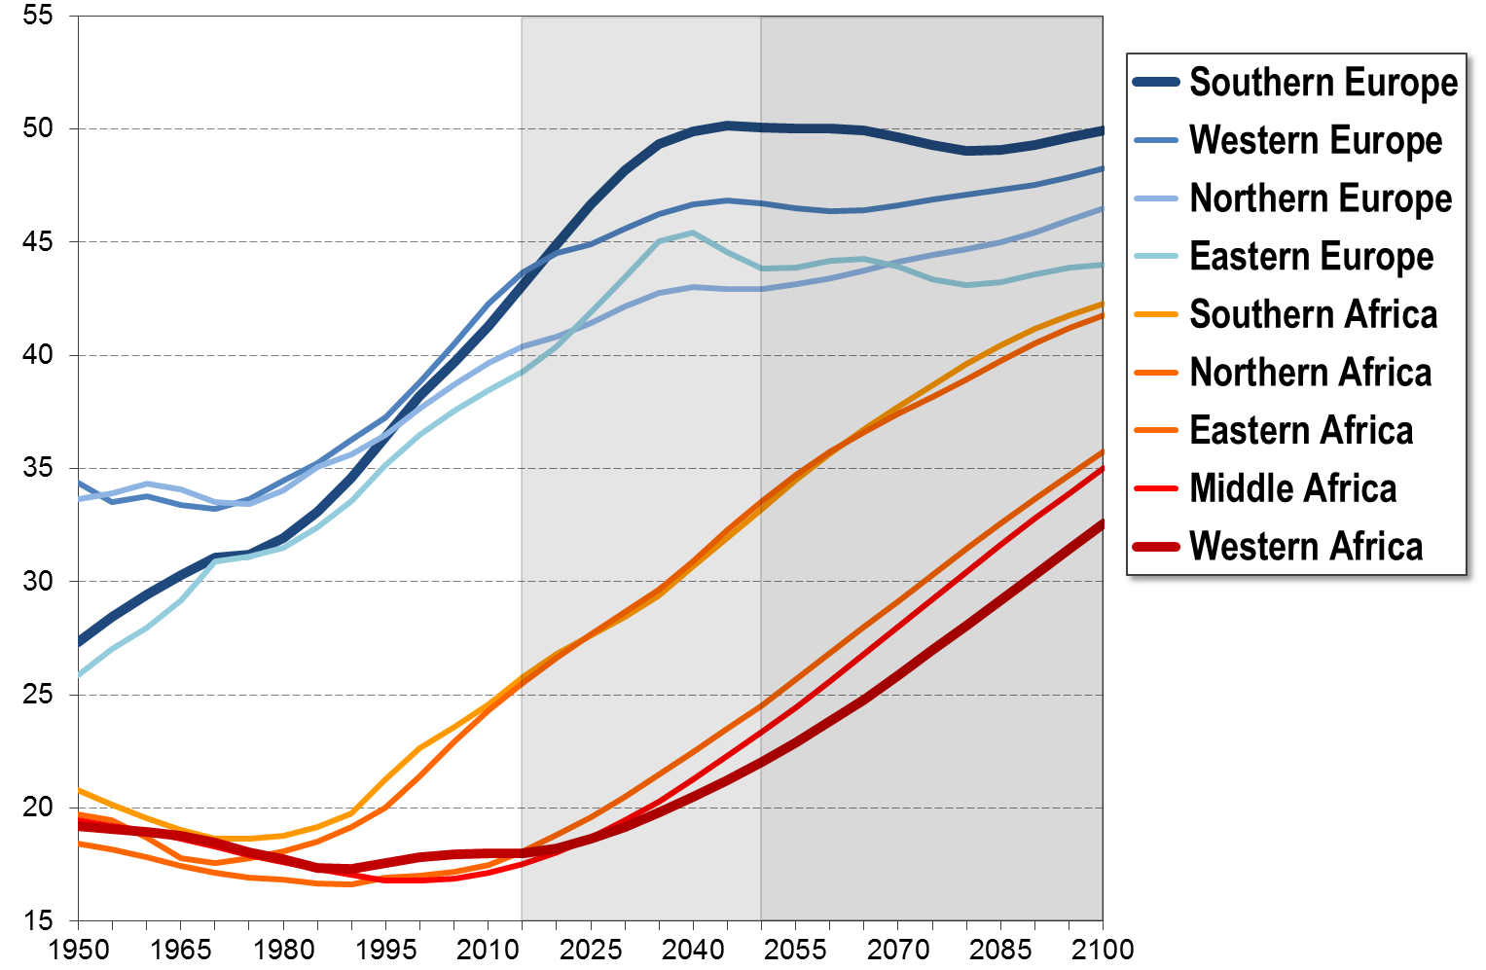
4
Africa - Europe: Median age, 1950-2100 (years)

Slide 32
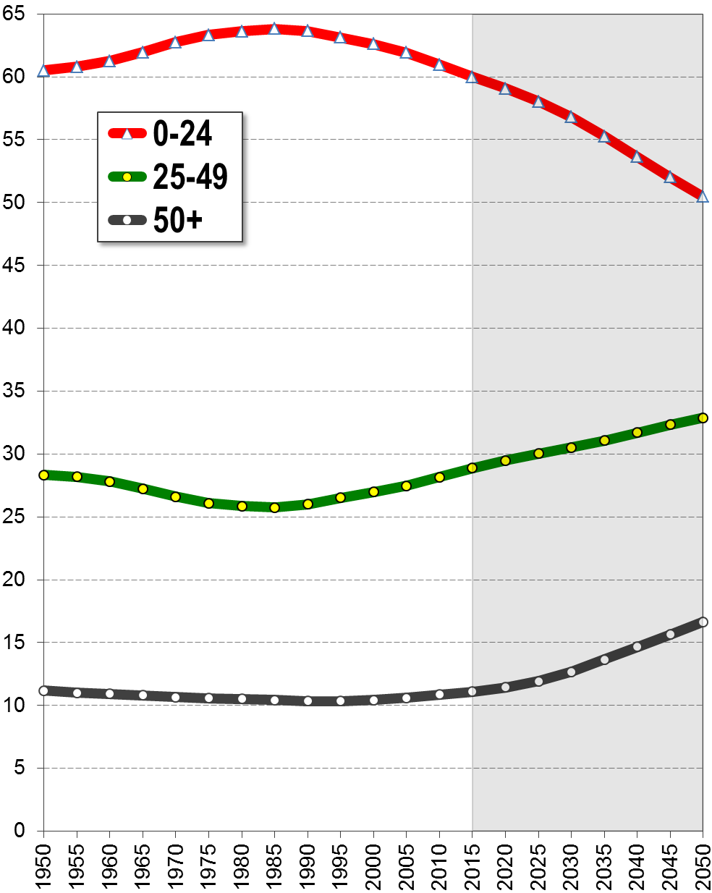
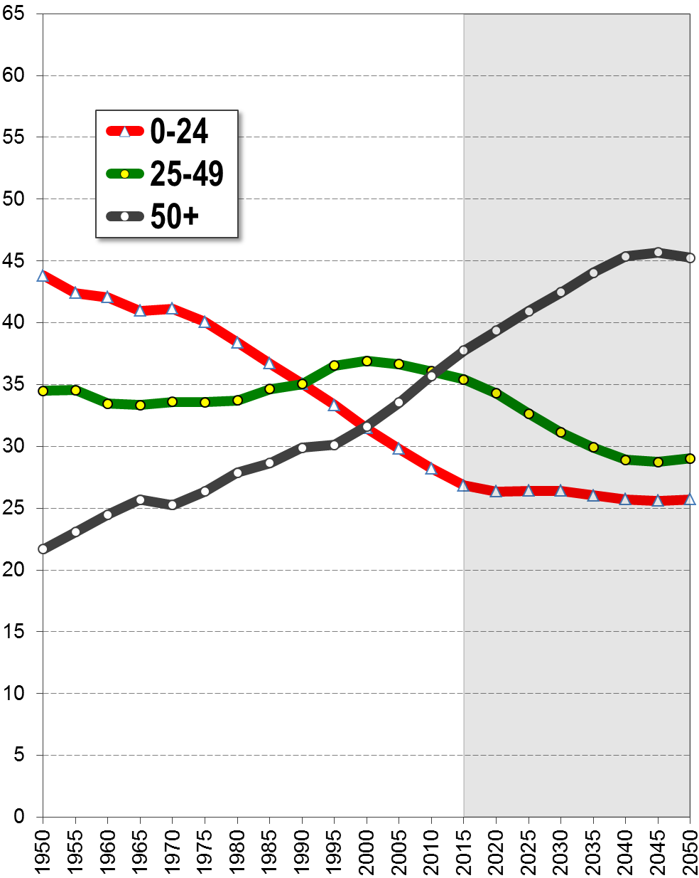
4
Population age structure
Population by age groups in percent of total population, 1950-2100
Africa
Europe
Europe’s “demographic window” has closed; high old-age dependency burden.

Slide 33
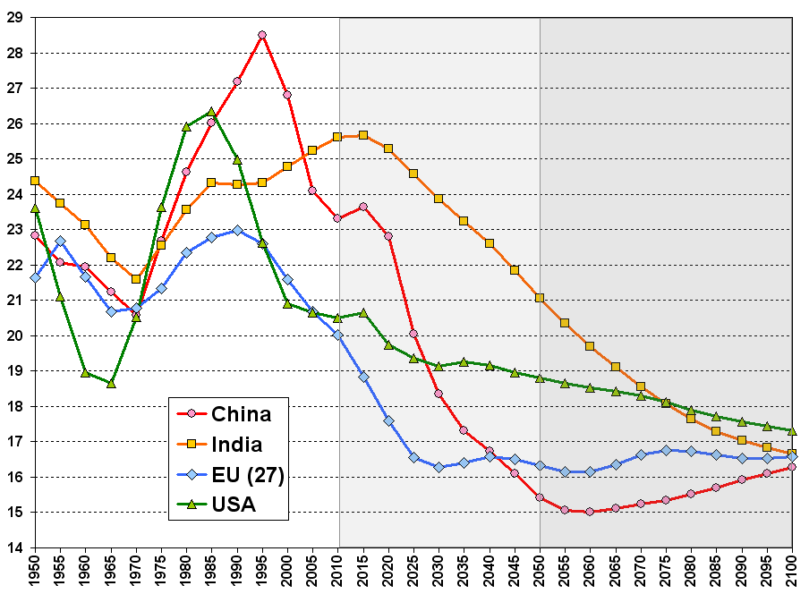
4
Prime working-age population(age 20-34 years)
Window
of economic
opportunity
percent of total population

Slide 34
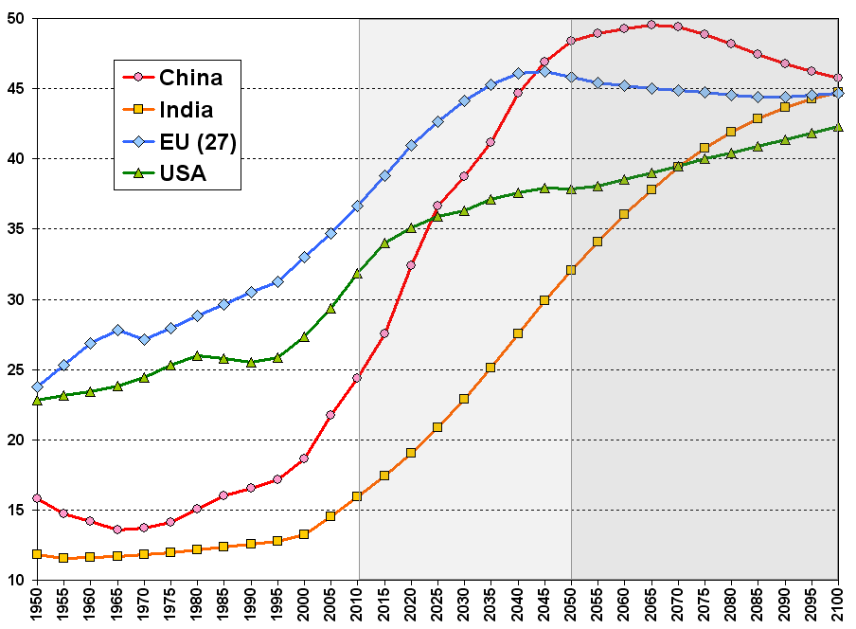
4
Population age 50+
percent of total population
Population
Ageing

Slide 35
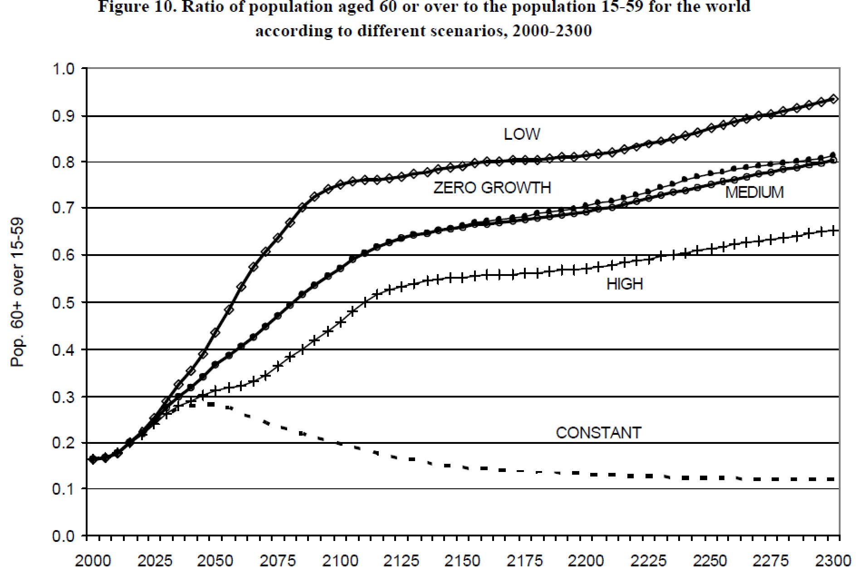
4
Population ageing, 2000-2300 (billion)
Population ageing will not stop!
Source: United Nations Department of Economic and Social Affairs, Population Division: World Population Prospects, the 2015 and 2917 Revision. New York

Slide 36
Long-range Population Scenarios
5
Possible Demographic
Catastrophes & Disruptions
Pandemics, Nuclear War, Climate Change
Medical Breakthroughs

Slide 37
5
Catastrophes: Pandemic
Why? | 1. Increasing population density / urbanization 2. Increasing mobility 3. Availability of biological weapons to terrorists 4. Ineffective antibiotics 5. Incomplete mass vaccinations against communicable diseases
Likelihood | Likely
Impact | Up to hundreds of millions casualties
Comment | Black Death: Killing over 75 mio. people in 1350 Spanish Flu (Jan. 1918 – Dec. 1920): 50 to 100 mio. (3%-4%percent of the world's population) – deadliest epidemic so far. AIDS-Epidemic (so far): 37 mio. people live with HIV infection. 2010: 1.8 mio. deaths due to AIDS
Literature | The Telegraph: Al-Qaeda cell killed by Black Death ‘was developing biological weapons’. 6:52AM GMT 20 Jan 2009 Ken Alibek and S. Handelman. Biohazard: The Chilling True Story of the Largest Covert Biological Weapons Program in the World – Told from Inside by the Man Who Ran it. 1999. Delta (2000) ISBN 0-385-33496-6

Slide 38
5
Catastrophes: Nuclear War
Why? | 1. Increasing political tensions from new global powers (China, India) 2. Proliferation of nuclear weapons to rouge regimes (Iran, North Korea) 3. Unintended nuclear war due to accidents, computer failure, sabotage 4. Proliferation of nuclear material for civilian use (nuclear power plants) 5. Terrorist may gain access to “dirty bombs”; may trigger larger conflict
Likelihood | Unlikely, but possible
Impact | Up to billions of casualties; mass-extinction of higher species
Comment | Darkness: War with high-yield weapons (US, Russia, China) would create 150 mio. tons of smoke that puts northern hemisphere into darkness Climate Change: Blocking of sunlight has far-reaching climate consequences (water cycle, temperature). Famine: Billions of people would starve to death, even when surviving immediate explosions Poisoning: Radiation and industrial toxins would make large areas uninhabitable
Literature | Owen B. Toon, Alan Robock, and Richard P. Turco (2008) Environmental consequences of nuclear war. American Institute of Physics, Physics Today M. A. Harwell, T. C. Hutchinson, Environmental Consequences of Nuclear War: Volume II: Ecological and Agricultural Effects, 2nd ed., Wiley, New York (1989)

Slide 39
5
Catastrophes: Climate Change
Why? | 1. Direct impact on food availability (agriculture, fisheries & livestock) 2. Impact on (urban) freshwater supply 3. Climate change might make regions uninhabitable (coastal areas, tropics) 4. Might trigger large-scale migration (migration conflicts) 5. Spread of tropical diseases (malaria)
Likelihood | Very likely, but probably does not have catastrophic impact
Impact | Millions casualties due to famines in Asia and Africa; Migration
Comment | Subsistence farmers in poor countries will be threatened by more frequent food crises (lack of technology & know how; poverty) Coastal cities Human settlements in coastal areas will become uninhabitable or will need enormous investments to protect against sea level rise. Malaria is already the world's most important and deadly tropical mosquito-borne parasitic disease. It kills about 1 million people and afflicts as many as 1 billion people in 109 countries throughout Africa, Asia, and Latin America. It is unclear, how climate change will affect the spread of Malaria
Literature | W. Buytaert and B. De Bièvre (2012) Water for cities: The impact of climate change and demographic growth in the tropical Andes. WATER RESOURCES RESEARCH, VOL. 48 John F. Morton (2007) The impact of climate change on smallholder and subsistence agriculture. Proceedings of the National Academy of Sciences (PNAS), 104(50): 19680–19685 J.E. Cohen (2010) Population and climate change. Proc Am Philos Soc. 2010 Jun;154(2):158-82.

Slide 40
5
Disruptions: Medical Breakthroughs
Why? | 1. Bio-medical research could lead to enormous increase in life expectancy 2. Poverty reduction and mass-vaccination programs can speeds up mortality decline (very low infant and child mortality)
Likelihood | Very likely
Impact | Both tend to increase population size; much higher life expectancy (>150 years) could significantly increase world population size
Comment | Infant & child mortality have already declined significantly in all countries worldwide; they can decline further with relatively simple measures. Modern world population growth is primarily the consequence of a dramatic and rapid decline in infant and child mortality Genetic and micro-biological research might identify the causes of aging and find simple aging therapy that extends average life span. A landmark study has recently identified a new way to replace ageing cells in our body.
Literature | Lori Dajose (2016) Turning Back the Aging Clock. California Institute of Technology (CALTECH) and UCLA. Original Study: Kandul, Nikolay P. and Zhang, Ting and Hay, Bruce A. and Guo, Ming (2016) Selective removal of deletion-bearing mitochondrial DNA in heteroplasmic Drosophila. Nature Communications, 7 . Art. No. 13100. (Study see: http://authors.library.caltech.edu/72178/)

Slide 41
Long-range Population Scenarios
6
Conclusions & Predictions

Slide 42
6
Ten demographic conclusions & predictions
Model | Prediction / Conclusions
 | World population will grow beyond 10 billion: NO end to world pop. growth
 | People will mostly live in urban areas
 | Wealthy cities will become greener and smarter for higher quality of life
 | Diversity of living conditions will not vanish; diversity might increase
 | Life expectancy will increase significantly (especially for the wealthy)
 | Population ageing is unavoidable – particularly for still high-fertility countries
 | Some populations might have sustained below-replacement fertility
 | Some populations (ethnic groups) will disappear; others will dominate
 | Medical breakthroughs might change everything. Example: Life Expectancy of 200y
 | Catastrophic world pop. decline is possible: Pandemic, nuclear war, meteorite
1
2
3
4
5
6
7
8
9
10
Source: United Nations Department of Economic and Social Affairs, Population Division: World Population Prospects, the 2015 Revision. New York

Slide 43
Thank you!
For more details and in-depth analyses go to:
www.demographics.at

Slide 44
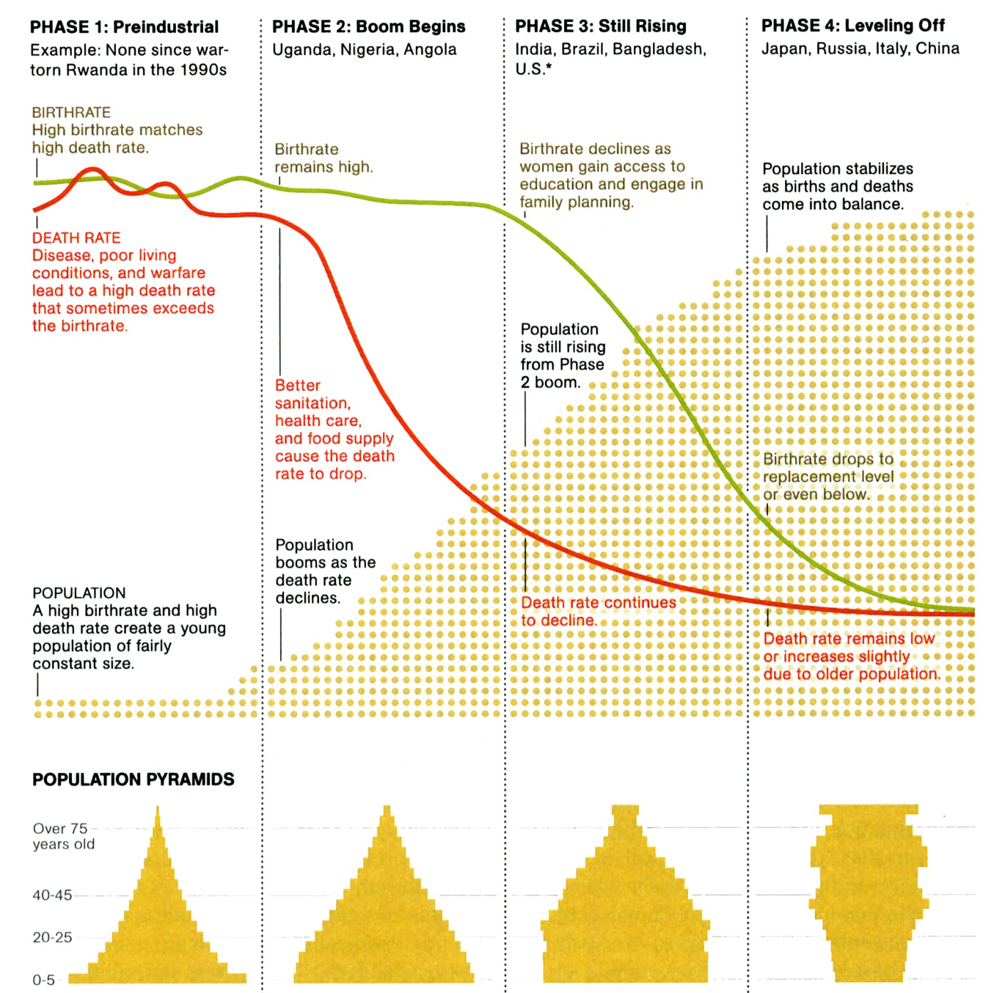
What has caused modern population growth?
The unprecedented increase in the world population did not happen because we were breeding like rabbits, but because we were no longer dying like flies.

Slide 45
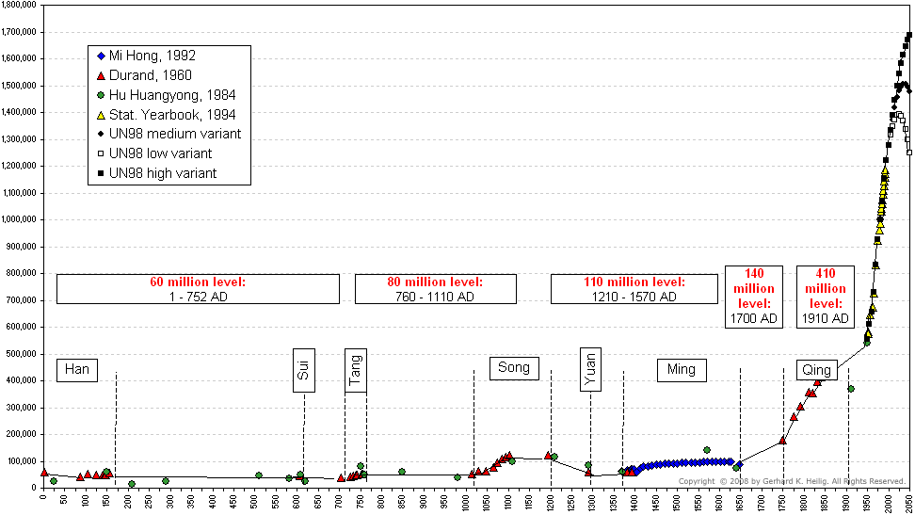
Evidence on population numbers: Example China
China's population, A.D. 0 - 2050
2010: 1.35 billion
Source: This chart was compiled by the author from the following sources: 1) Durand, J.D. (1960): The population statistics of China, A.D. 2 - 1953. In: Population Studies, Vol. 13, No. 3, 209-256; (2) Mi, Hong (1992): The quantitative analysis about evolution of historical population on Ming Dynasty in China. Paper presented at the IUSSP General Conference, Session 40, Montreal; (3) Hu Huanyong (Ed.) (1984): The population geography of China. Shanghai (East China Normal University Press), p. 10 (taken from Susumu Yabuki (1995): China's new political economy. The giant awakes. Boulder, San Francisco, Oxford, Westview Press, p.96); (4) China Statistical Yearbook, 1994, Beijing. China Statistical Publishing House. (5) United Nations (1999): World Population Prospects. The 1998 Revision. New York (from data files on diskettes)

Slide 46
The true size of Africa

Slide 47
Disclaimer
This presentation is not a United Nations publication.
It is a private project, authored by Gerhard K. Heilig. Views expressed are those of
the author and do not imply the expression of any opinion on the part of any international
organization or research institute.
This presentation is using data from the official United Nations “World Population Prospects” (WPP),
the “World Urbanization Prospects” (WUP) and the “Probabilistic Population Projections” (PPP) for all countries of the world, as published by the United Nations Population Division of the
Department of Economic and Social Affairs.
The official data are available on the following official websites:
For the World Population Prospects: http://esa.un.org/unpd/wpp/
For the World Urbanization Prospects: http://esa.un.org/unpd/wup/
For the Probabilistic Population Projections: http://esa.un.org/unpd/DVD/

Slide 48

Copyright
I, the copyright holder of this work, hereby publish it under the following licenses:
This file is licensed under the Creative Commons Attribution-Share Alike 3.0 Unported license.
You are free:
to share – to copy, distribute and transmit the work
to remix – to adapt the work
Under the following conditions:
attribution – You must attribute the work in the manner specified below (but not in any way that suggests that I endorse you or your use of the work).
share alike – If you alter, transform, or build upon this work, you may distribute the resulting work only under the same or similar license to this one.
I, the copyright holder, request that you attribute this work as:
“Long-range Population Scenarios”. PowerPoint presentation by Gerhard K. Heilig, 16 August, 2017 (www.gerhard-k-heilig.com)”

